Slide 1
Slides that need local information and speaker notes
7, 12, 13, 14, 15, 72 and 73

Slide 2
Forces Connect South East Armed Forces Service Champion Training
Adapted from
Sussex Armed Forces Network

Slide 3
Welcome, aims and objectives
Why are you here?
What is the Armed Forces Covenant?
Who are the Armed Forces Community?
How we can better understand their needs?
Provide you with the knowledge and skills to better support this community
Other sources of support – Service Charities
You as a Service Champion (including resources)
Notes:
Structures and research – required for CPD.
Needs to be evidenced based

Slide 4
The Armed Forces Covenant
The Armed Forces Covenant is a promise from the nation ensuring that those who serve or who have served, and their families, are treated fairly.
“Parity not priority”
Notes:
Talk through obligations, responsibilities and background appropriate to authority

Slide 5
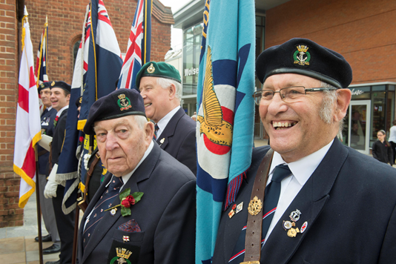
Who are the Armed Forces Community?

Slide 6
Forces Connect South East Cross Border MoD Project
Strengthening local government delivery of the covenant
Two year project
“Promoting a greater understanding and awareness of the issues affecting the Armed Forces Community within public authorities to ensure the Covenant is embedded and mainstreamed in service delivery, through sharing and building on best practice.”
Notes:
£321,300

Slide 7
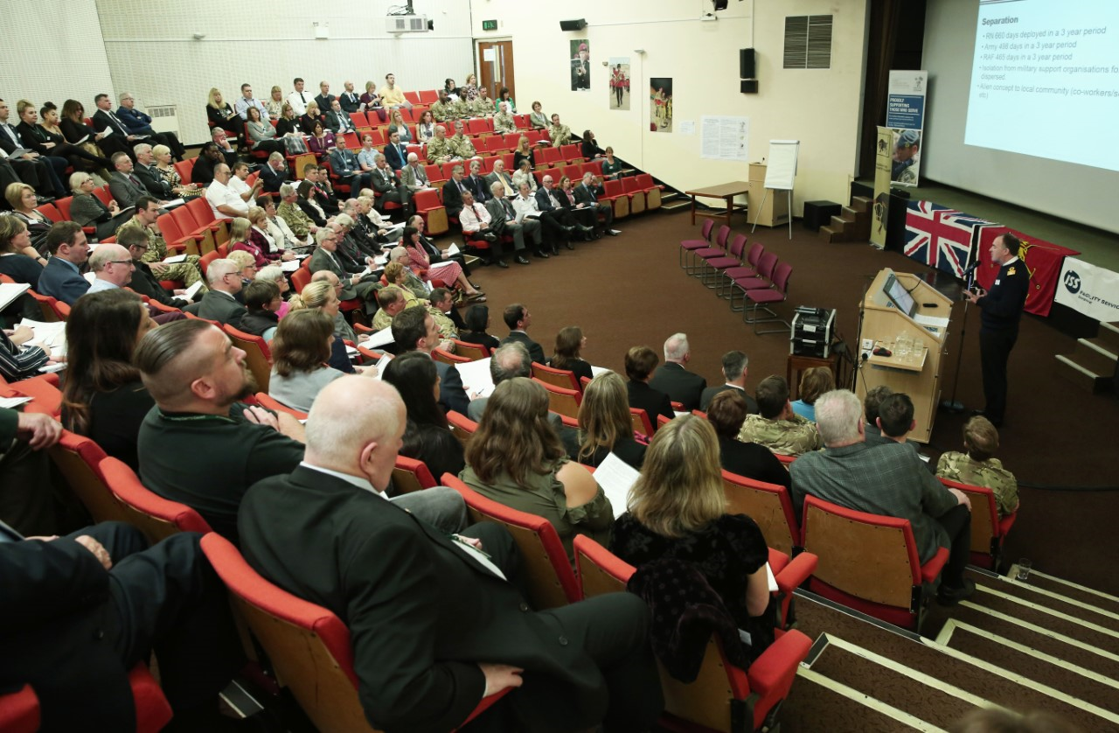
Civilian Military Partnership Board
High Level remit to foster working relationships between lead agencies and military partners.
In Surrey two tasks groups:
Recognise and Remember
Community Integration
Insert Local Information
Notes:
Make authority specific
Kate F has sent through info for hants

Slide 8
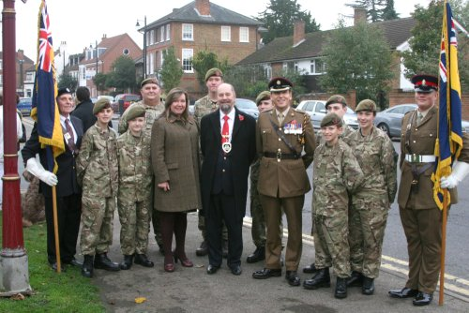
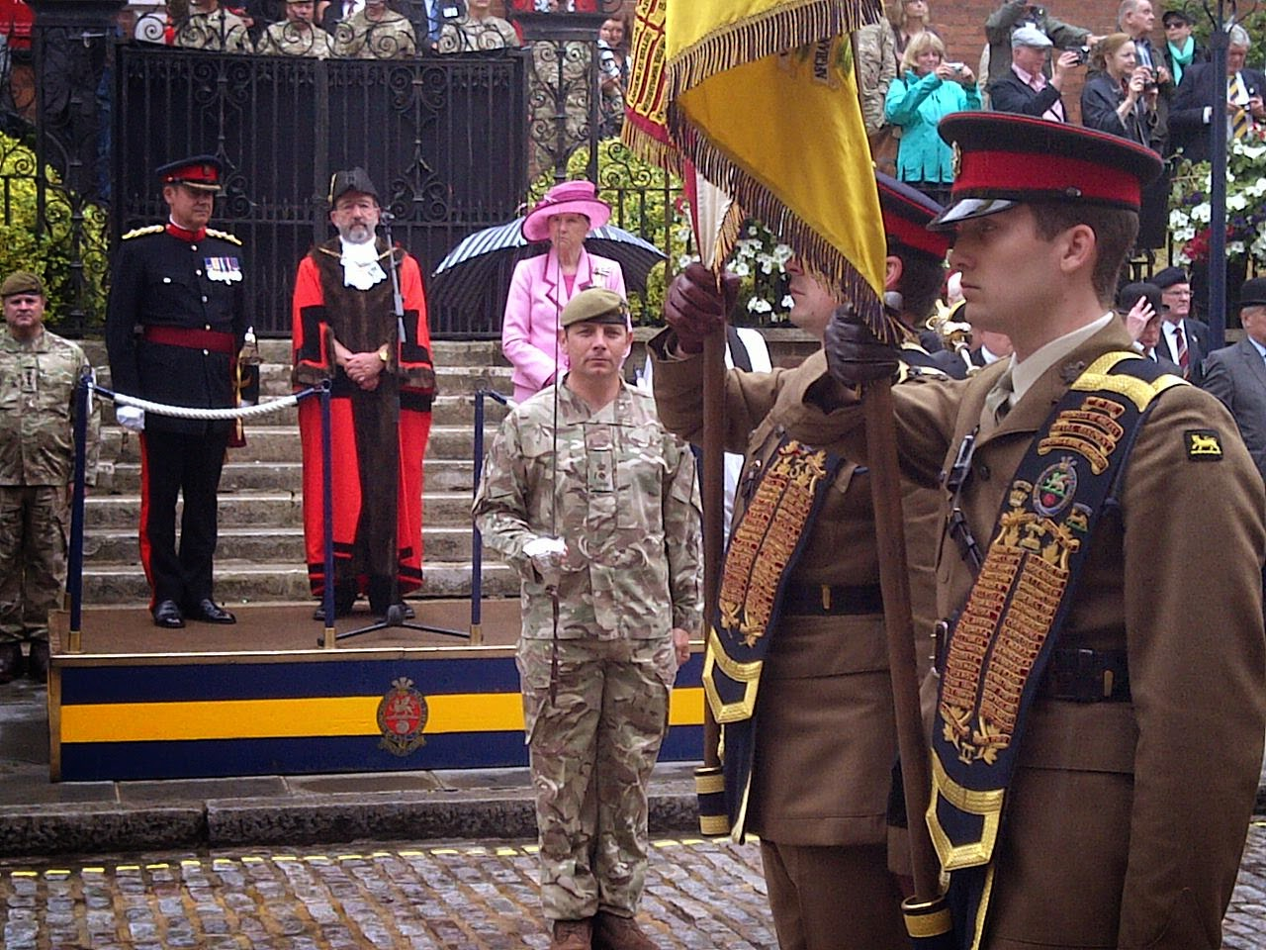
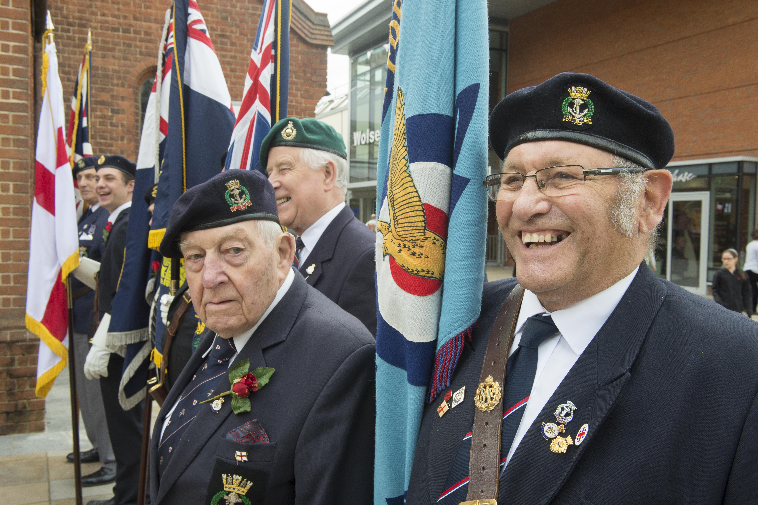
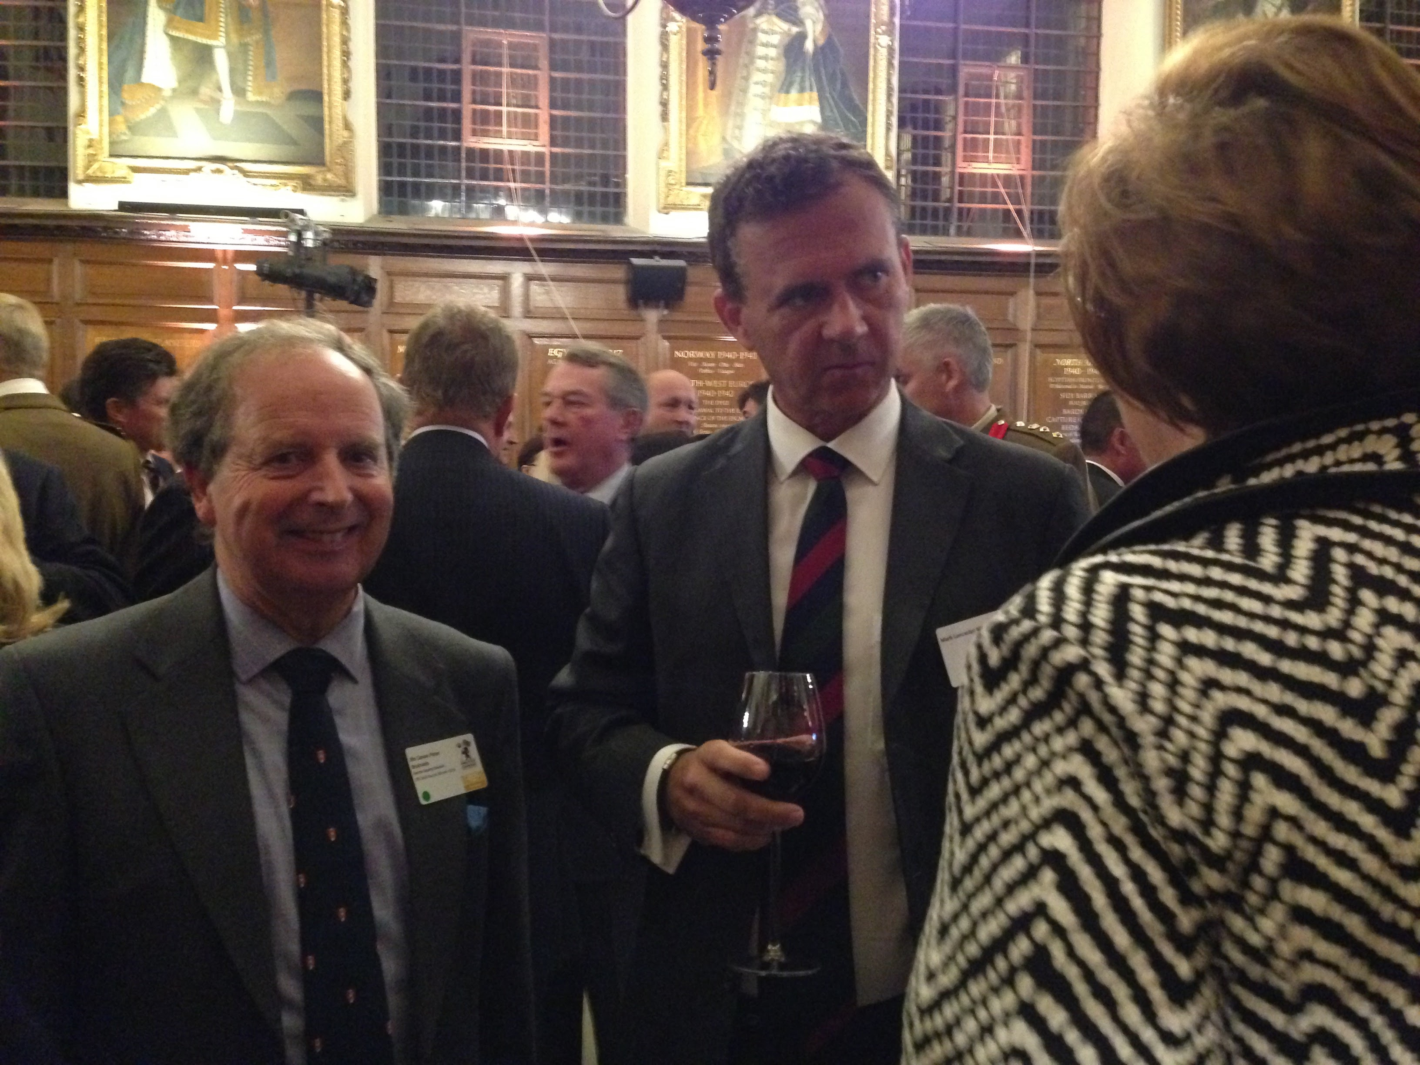
Councillor Armed Forces Champion
Raise profile and needs of Armed Forces Community within the council and local authority area:
Annual meetings, links with MPs
Remembrance and ceremonial
Notes:
To raise the profile and help address needs of the Armed Forces Community
Liaise closely with Council representative on Surrey Civilian Military Partnership Board.
Liaise closely with the Council Officer appointed to lead on work related to Armed Forces Community Covenant.
Set up (where appropriate) and lead on the work Armed Forces Members panel.
To liaise as appropriate with members of local Armed Forces.
To promote the Armed Forces Covenant to the business community.
To keep abreast of national developments in relation to promoting Armed Forces Covenant and military-civilian engagement.
To sponsor an annual report on Covenant activities.
To keep the Mayor/Chairman, local Churches and local MP aware and involved on ceremonial matters
But there are other champions Over time 5 types of Armed Forces Champions have developed
Armed Forces Champions – Elected Councillor
Armed Forces Champions – Behind the wire
Armed Forces Service Champions – CPD trained
NHS Reserve Forces Champions – NHS Employers
Informal Armed Forces Champions – Many organisations nominate individuals who takes the lead.

Slide 9
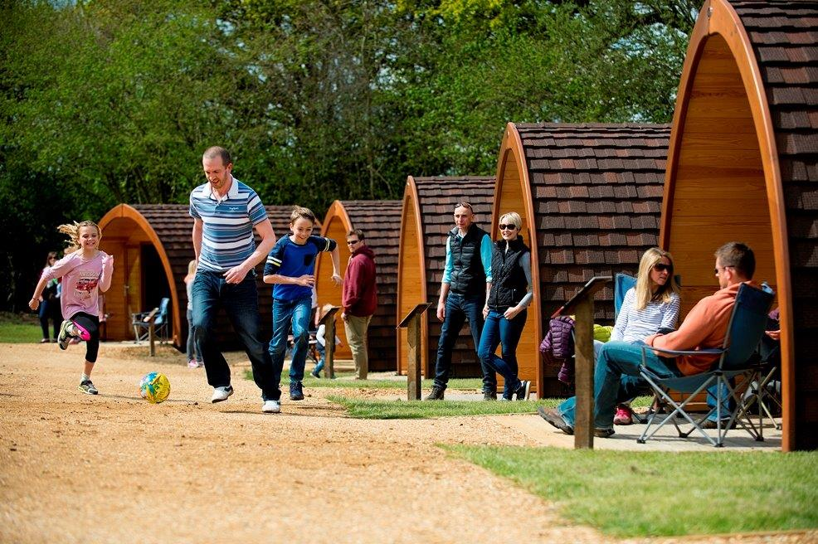
Armed Forces Covenant Grants
Strengthening local government delivery of the covenant (up to £500k)
Local Grants (up to £20k)
Community Integration
Delivery of local services

Slide 10
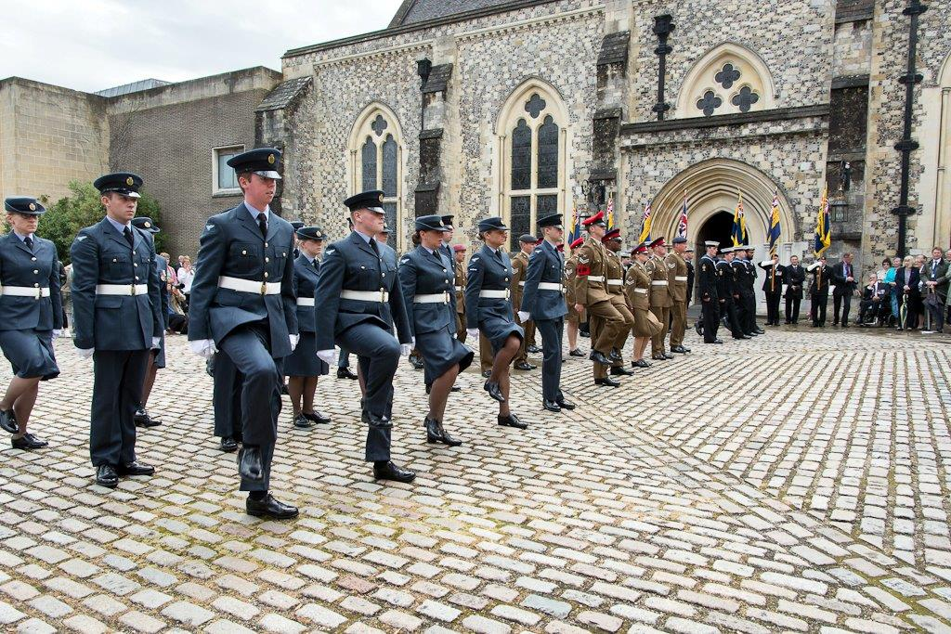
Armed Forces
Tri-Service Video

Slide 11
Armed Forces Personnel Restructure
38,000
2,930
2010
2015
2020
29,710
2,190
Regular
Reserve
30,600
3,100
104,000
19,000
2010
2015
2020
82,000
22,000
82,000
30,000
42,500
1,500
2010
2015
2020
31,250
1,740
31,750
1,860

Slide 12
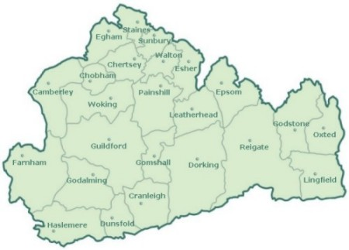
The Armed Forces Community
Insert Local Information
Regular
Reserve
Notes:
Need to overlay the army and reserve bases
Local Map showing bases –

Slide 13
Armed Forces Community
 | Now | Changes
Regular Army ARMY REBASING 2020 REFINE | 6200 Serving military 680 Military Families (1265 service children in 184 Surrey Schools) Royal Alexandra / Gordons £300 Premium) | 1Welsh Guards-Windsor 2019 4 Armed Regt Tidworth 2019 22Field Hosp Nuneaton 2020 27 Regt RLC Catterick 2021 Headley Court closes in 2018 Deepcut closes in 2019 ATC Pirbright/Keogh Barracks
Army Reserve | 250+ | A Coy 4 PWRR FARNHAM 4PWRR HQ REDHILL April 2018 2Trp 579 Fld Sqn 101 EOD REIG 135 Geo Sqn RE - EWELL
Cadets: ACF CCF | 27 Detachments (750) 12 Contingents (1200) 192 Cadet Adult Vols | Royal Alexandra & Albert Sch Ash Manor CCF (Grenadiers) NB Sea Cadets: 8 ATC: 12
Service Leavers | 8000 pa (Army) 10% to settle in SE | 50% have no idea where 50/100 in Surrey per annum
Insert Local Information
Notes:
13
People living outside the county
Serving outside the county
Cadets not part of AFCs

Slide 14
AFC Veteran Population
County | Number to nearest ‘000 | Percentage of County population that are veterans
East Sussex | 36 | 5%
Hampshire | 90 | 6%
Kent | 73 | 5%
Surrey | 42 | 5%
West Sussex | 42 | 6%
Insert Local Information
Notes:
Surrey Heartlands STP
(not including East Surrey)
680 Entitled Civilians
2,110 UK AF
30,689 Veterans
Add area specific info
Population stats in Hampshire – please use only those on gov.uk website & speak about RBL census drive
https://www.gov.uk/government/statistics/annual-population-survey-uk-armed-forces-veterans-residing-in-great-britain-2016 and https://www.gov.uk/government/statistics/location-of-armed-forces-pension-and-compensation-recipients-2017
AFC is size of one of the district councils eg Eastleigh Borough Council

Slide 15
AFC Veteran Population
Local Authority | AFPS | War Disablement Pension
Elmbridge | 235 | 119
Epsom and Ewell | 100 | 69
Guildford | 590 | 217
Mole Valley | 201 | 97
Reigate and Banstead | 266 | 147
Runnymede | 168 | 72
Spelthorne | 192 | 109
Surrey Heath | 693 | 167
Tandridge | 178 | 111
Waverley | 243 | 187
Woking | 93 | 78
Insert Local Information
Armed Forces Pension and Compensation (AFPS) Recipients

Slide 16
Structure of the Services
Notes:
The British Armed Forces are Structured and trained for operations, not for the convenience of administration in barracks/units. On joining the Armed Forces service men and women accept a commitment to serve whenever and wherever they are needed, whatever the difficulties or dangers it may be. Such commitment imposes certain limitations on individual freedom, and requires a degree of self-sacrifice. Ultimately it may require members of the Armed Forces to lay down their lives. Implicitly it requires those in positions of authority to discharge in full their moral responsibilities to subordinates.
Within the services there are a rich and varied number of rolls and trades (RM 105 rolls, Army 170 rolls and 64 in the RAF)

Slide 17
The UK’s Armed Forces have 7 core military Tasks:
defend the UK and its overseas territories
provide strategic intelligence
provide nuclear deterrence
support civil emergency organisations in times of crisis
defend our interests by projecting power strategically and through expeditionary interventions
provide a defence contribution to UK influence
provide security for stabilisation
Notes:
The Role of the UK’s Armed forces is to protect the security, independence and interests of our country at home and abroad. They work with our allies and partners whenever possible. The MOD’s aim is to ensure that the armed forces have the training, equipment and support necessary for their work within budgets.
All three services have now fully integrated the reserves into their regular forces

Slide 18
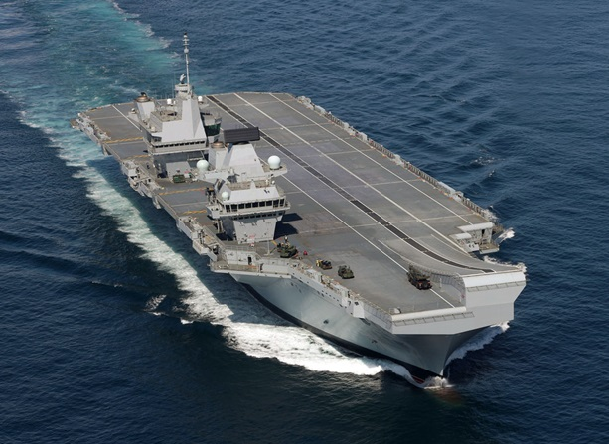
In times of conflict or peace, the Royal Navy is key to the prosperity of Britain and the stability of the high seas, projecting naval strength around the globe 24/7 and 365/365. The RN is made up of five arms; the might of ships in the Surface Fleet, the aerial strength of the Fleet Air Arm, the covert Submarine Service, the elite and amphibious Royal Marines, and the Royal Fleet Auxiliary.
Notes:
Naval families tend to be more static – live near family rather than on base. Deployments typically longer than other services – approx. 9 months
The Royal Navy is made up of a fleet of 77 commissioned ships.

Slide 19
The British Army is the UK's principal land warfare branch who are actively engaged in operational duties across the globe. The work they do ranges from peacekeeping to providing humanitarian aid, from enforcing anti-terrorism measures to helping combat the international drugs trade.
Notes:
Public friendly what they do – ebola, fighting, logistics, intelligence, civil engagement etc
Gurkhas (extra slide as necessary)

Slide 20
The RAF currently comprises some 39,400 uniformed men and women operating 1,100 aircraft from a dozen main operating bases within the United Kingdom and at a number of airfields overseas. Securing control of the air is the RAF’s paramount duty: most importantly, in defence of the United Kingdom itself, but also on expeditionary operations, where control of the air guarantees the freedom of manoeuvre and action of friendly air, land and naval forces.

Slide 21
Service Culture
Service Culture is strongly based on its values and standards.
The Services’ values and Standards demand a degree of commitment and self-sacrifice which goes beyond that normally expected from other citizens.

Slide 22
Values and Standards
Courage
Discipline
Respect for others
Integrity
Loyalty
Commitment
Responsibility
Teamwork
Notes:
Common values and standards

Slide 23
Service Life
Mobile – frequent deployments home and abroad resulting in disruption to family life
Accommodation
Structured Life
Free health care – medical and dental
Fitness - free access to fitness and sports
Good pay
Notes:
On average RN personnel deploy more often and for longer than their other service counterparts - standard RN ships' deployments are now 9 months, and separated service rules dictate that RN people are away more (for some very good operational reasons). to family life
Lack of postcode

Slide 24
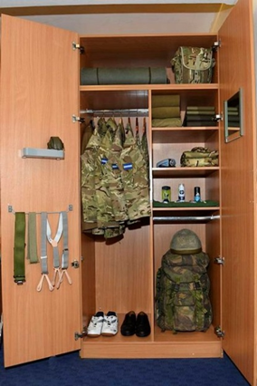
Service Life
Work-live-socialise with work colleagues
Gallows humour
Clear command structure & decisive leadership
Trust in those in command & work with
Loyal
Self-esteem – Pride in unit and, achievements

Slide 25
Support provided by the Armed Forces
Unit Welfare Officers
Family Federations
Benevolent Funds
Padres
Awareness of Covenant

Slide 26
Leaving the Services ‘Transition’
Resettlement Policy for service leavers – Career Transition Partnership (CTP)
Support provided from beginning to end of service
Not used to accessing public services
Individual planning and personal development:
through career advice
Employment, Education, Housing, Health and Welfare
Enhanced Learning Credits – professional qualifications
personal and professional development
Notes:
4yrs=3x£1000, 6 years=1x£3000 (aggregated), 8+yrs=3x£2000
Give examples of what credits can be used for

Slide 27
Transition/Resettlement Relationship
Discharge
Enter Service
Resettlement
Old
Resettlement
New
Through–career Individual Planning & Personal Development “E2H2W”
Service Leavers’
preparation for civilian life
Length of Service

Slide 28
Assessing Additional Support Needs
Health
Accommodation
Relocation
Drugs, alcohol and stress
Finance
Attitude
Children and family
Training and education
Supporting agencies
Notes:
Mention Veterans UK
HARDFACTS

Slide 29
Facts about a Service Person’s Future
29 years – average age of service leaver
1% - serve a full 22 year career
A Service person will probably work in civilian employment for longer than their Service careers
Resettlement support is based on length of service
The public respects the Service’s achievements but is largely uninformed of their qualities and capabilities

Slide 30
Life after Service
Leaving the Services is unlike simply changing jobs; it is a wholesale life change in which the Service leaver discards more than just employment.
They also relinquish their accommodation and the camaraderie of Services life. They undergo a radical change in lifestyle.
They enter civilian life having to discard the familiar trappings of the Services including the relationship between different ranks and the discipline of an organised and relatively institutionalised existence.
Notes:
Many more RN personnel own their own homes in comparison to the Army and RAF. RN spouses are more likely to be in work, RN families are more likely to live away from main base areas among the wider civilian community, and serving RN personnel are more likely to "weekend commute" to a home base. This means they can be relatively isolated from the support provided by the bases and organisations such as the NFF.
RN family may well on average be different to those of an Army or RAF one, with respect to dealing with a local authority

Slide 31
Impact of Service life
on families

Slide 32
Mother, Naval family
“Many families are separated because of their work – for instance the families of oil rig workers or long distance lorry drivers.
But what is unique to Service families, and what makes such a distinction, is the element of uncertainty. You don’t know what’s going to happen to your loved one”

Slide 33
UK Armed Forces Families Strategy 2016
Vision: ‘Resilient, empowered, thriving Service families, who are treated fairly, have increased choice, and who are valued by the Nation’
Notes:
What is important to note is that the Services have different perspectives on family life.
Many more RN personnel own their own homes in comparison to the Army and RAF.
RN spouses are more likely to be in work,
RN families are more likely to live away from main base areas among the wider civilian community, and serving RN personnel are more likely to "weekend commute" to a home base. This means they can be relatively isolated from the support provided by the bases and organisations such as the NFF

Slide 34
Emotional Cycle of Deployment
Notes:
What is important to note is that the Services have different perspectives on family life. The NFF can probably provide you with figures, but many more RN personnel own their own homes in comparison to the Army and RAF. RN spouses are more likely to be in work, RN families are more likely to live away from main base areas among the wider civilian community, and serving RN personnel are more likely to "weekend commute" to a home base. This means they can be relatively isolated from the support provided by the bases and organisations such as the NFF. On average RN personnel deploy more often and for longer than their other service counterparts - standard RN ships' deployments are now 9 months, and separated service rules dictate that RN people are away more (for some very good operational reasons). All these factors mean that the needs of an RN family may well on average be different to those of an Army or RAF one, with respect to dealing with a local authority

Slide 35
Impact of Service life
on families
Naval Video

Slide 36
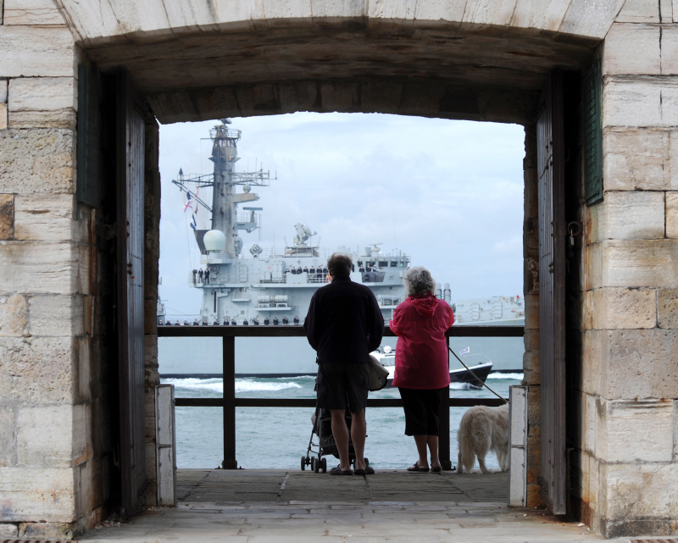
Armed Forces carers
‘One in four working age members of the ex-Service community have unpaid caring responsibilities which is considerably higher than the rate found in the general population’
23% vs 12%
A UK Household Survey of the Ex Service Community in 2014’ (RBL Report)
Notes:
4 hour – talk about stigma in 4 hour (8 hour separate slide)

Slide 37
Armed Forces Young Carers
Service children who are young carers may be caring for:
A serving parent who has returned from deployment and is injured physically or experiencing mental health needs including PTSD
A non-serving parent remaining at home who is affected by illness or disability.
Sibling(s) or other family members affected by illness or disability.
Some serving personnel aged 18 to 25 have been identified as young adult carers caring at a distance and during leave for parents or siblings at their family home.
Notes:
EMOTIONALLY - Putting other people’s needs first, being worried, anxious or stressed. Feelings of guilt, anger, being trapped, isolated and being misunderstood.
PHYSICALLY - Suffering from pains or strains from heavy lifting or helping someone to wash or dress.
SOCIALLY - Not able to meet up with friends regularly. Feeling isolated and lacking confidence. A possible target for being bullied.
EDUCATIONALLY - Difficulties concentrating in class, feeling tired, worried, with no time to do homework.
FINANCIALLY - Low family income. Not having enough money for basic needs.
Census data for young carers underestimates the true number
In Surrey it is estimated there are 14,030 young carers between 5-18 years old
4 hour
our

Slide 38
Additional pressures for Military Young Carers
They may not have the support network of “full time” military families (Reservist Families)
They don’t always know where to access support
The family may have to move frequently
May live some distance from extended family/friends
They may not have peers who understand the effects of military life
“Moving around a lot is very hard because you don’t know where you are going to or what help there might be.”
(Military Young Carer, aged 14)
Notes:
Average number of schools (Royal Navy & Royal Marines Children’s Fund, 2009)

Slide 39
Education and schooling
Service children can face big challenges, such as emotional strain due to parents being deployed, frequent house moves and problems with admissions to schools
Service children may change schools up to 11 times during their school career
Notes:
Average number of schools (Royal Navy & Royal Marines Children’s Fund, 2009)

Slide 40
Education and schooling
Early years childcare
School admissions – process, practicalities and Policy
Attainment
SEN – Special Education Needs
School transport
Service Pupil Premium
Involvement of Service families in schools – PTA, Governor, classroom helpers etc
National research
Notes:
• When allocating places to oversubscribed schools, admission authorities may give priority to Service children eligible for the Service Pupil Premium.
• Service children may be given priority on any waiting lists for oversubscribed schools, if the admission authority chooses to do so.
• Admissions authorities must accept a unit address as proof of address for the purposes of applying for a school place in advance of the move taking place. This is useful if a family knows they are moving but does not yet have a new home address.
• Service children admitted in-year are ‘excepted pupils’ for infant (Reception to Year Two) class size limits, currently set at 30, which means an admission authority may offer a place, even if the class size limit will be breached.
Special Educational Need and Disability (SEND)
If your child has SEN or SEND, the Ministry of Defence advises you to contact the
Children’s Education Advisory Service (CEAS) and register your child.
What should the SPP be used for? The Ministry of Defence states that:“ Eligible schools receive the SPP so that they can offer mainly pastoral support during challenging times and to help mitigate the negative impact on Service children of family mobility or parental deployment.”
http://media.britishlegion.org.uk/Media/10334/rbl_education_guide_a5_web.pdf?_ga=2.16370038.1123192553.1512655687-366447898.1510929716
HCC – School briefings and district networks, Winchester Univ (Kate P has uni contact)
SCC Schools termly newsletter
Further bid to Covenant Fund to improve outcomes for service children, esp at schools with 1 or 2 service children

Slide 41
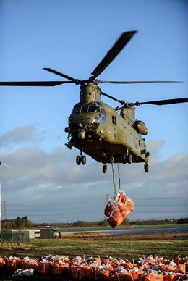
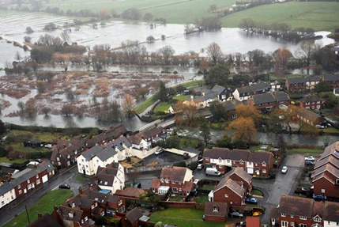
Real Life Experiences
Unit Life
Training
Deployment
War Fighting
Peace Support
UK Operations
Rear Party/Rear Operations
Notes:
War fighting, peace keeping, transition
Unit Life
Unit Life
Training (Deprivation and discomfort)
Deployment War fighting (Deprivation and discomfort)
Peace Support (Exposure to Atrocities)
UK Operations
Rear party/Rear Ops

Slide 42
Service delivery for Public Authorities

Slide 43
Ask the question
Have you or any member of your immediate family ever served in the Armed Forces?
Accurately identify members of the Armed Forces community accessing services
How do you know you are not disadvantaging if you haven’t asked the question?

Slide 44
Accessing health
Joint Strategic Needs Assessment
Registration with GPs and dentists
NHS Choices
Qualification for priority healthcare
Waiting lists after redeployment
Reservists

Slide 45
Health
Sight Loss
Chavasse report
Musculoskeletal
Hearing loss
Amputees
IVF
Alcohol/substance misuse
Mental health Understanding specific needs of minority groups (Gurkha, Foreign & Commonwealth)
Notes:
Mention waiting lists
Carers needs assessment – legal duty
‘Between 2007 and 2013, up to 11,000 serving members of the military were diagnosed with mental health conditions including post-traumatic stress disorder (PTSD) and depression. Many more suffer from existing conditions, go un-diagnosed and untreated’
(Centre for Social Justice, ‘Military Families and Transition’ Report, 2016)
PTSD – 4% same as population, though Reservist deployed 5-6%
www.kcl.ac.uk/kcmhr/pubdb
Veteran wanted support with having an assistance dog to help with his PTSD referral made to Service Dogs UK, dog now with individual and training on-going.
The rates of common mental disorders in deployed reservists are found to be higher.
1 in 4 (2015/16), 1 in 3 (2017) 18%-19.9%
Rates of PTSD the same but complexities generally greater
Adjustment disorder , Anxiety and Depression

Slide 46
Adult Social Care
Additional support available for Veterans
Those who served for a day including everyone who did National Service served (born before 1943)
Establish if served
Signpost to service charities if appropriate
Look out for trends and issues
Safeguarding
Carers Assessment
Notes:
HCC www.connecttosupporthampshire.org.uk
Surrey link - https://www.surreycc.gov.uk/people-and-community/advice-guidance-and-support/armed-forces/support-for-current-and-ex-service-personnel

Slide 47
Road safety
Military personnel are twice as likely to die on the road compared to civilians
Motorcyclists under 30 years of age in the Army are also twice as likely to die on the road compared to a civilian
Significantly more chance of killing your ‘buddy’ as a passenger in your own car than by a civilian
Notes:
Ref stats

Slide 48
Criminal Justice System
Most reliable statistics show that ex-Service personnel make up between 3.5% - 7% of the prison population in England and Wales
Court Diversion Scheme
Custody
Peer Mentoring – Care After Combat Charity
Local trends (e.g. HMPS Winchester)
Domestic Abuse
Notes:
(how does this compare to military % within whole UK population?? PLEASE ADD)
Court diversion scheme – Please check whether this is whole region for just Hants
Most reliable statistics show that ex-Service personnel make up between 3.5% - 7% of the prison population in England and Wales - often of a violent nature due to the skills training and mixed with the above issues.
SSAFA work with the rehabilitation team providing funding for deposit for accommodation for example
Police attending incidence, custody and court liaison service
Ask the question and link them into mental health and military support (SSAFA/Veterans Gateway)
k

Slide 49
Housing
Homelessness
Waiting lists
Local Connection
Rehabilitation of offenders
Veterans Housing Advice
Managing expectations
Notes:
Location connection – base 6 months
Waiting lists – stay on list if deployed
Bedroom tax
Rough Sleeping A recent study showed that only 3% of rough sleepers in London in 2013/14 had ever served in the UK military. Brighton 0.5% but it fluctuates.
Sleeping in the car (services pulled together to get the individual into a safe environment)
Housing National Guidance – Housing Policy not disadvantaged.
MP wanted to have support around housing, contact was made with manager at council who supported the individual.
Don’t live in the area (5 years post leaving)
Vulnerable Veteran
Family – Divorce or separated should be given the same consideration

Slide 50
Employment
Spousal employment
Multiple short term employment history
Skills training
Jobs on leaving the Service
Signposting, Careers Fair
Public sector services as an employer
Mentoring
MoD Employer Recognition Scheme
Forces Friendly Employers
Flexible working
Reservists
Links with local business
Economic Development
Support and growth in Defence
industries
Notes:
Hants CC – Economic Development info

Slide 51
Specific welfare Needs
Children – safeguarding and education
Debt - CAB
Loneliness
Mobility
House adaptations
Third sector

Slide 52
Other Public Sector interactions
Role models within communities - volunteering
Contact Centres and Libraries
signposting to information
Benefits and job centres
Police - victims of crime
Fire and Rescue Service
incidents, home fire safety visits for vulnerable
Ambulance Service

Slide 53
Miscellaneous Issues Covenant has helped with
Car insurance
Mortgages – Buy to Let
Mobile phone/broadband contracts
Armed Forces Railcard
Creates employment opportunities
Notes:
Businesses sign up to the covenant to work with the MoD to better understand the community and create opportunities

Slide 54
Service Charities
Adjunct to, not a replacement for statutory assistance.
Multiplicity of charities (~2500): regimental, health, benevolence, children, ethnic and geographical etc.
Notes:
So very confusing difficult to access for layman

Slide 55
COBSEO
Guardian of good service charities
Provides single point of contact with all stakeholders

Slide 56
Veterans Gateway
Service launched in response to Lord Ashcroft’s 2014 Veterans’ Transition Review, which called for the confusing support system for veterans to be simplified to:
One 24/7 contact centre
Single free Phone number
A website address
Instant client transferrals to appropriate person
Easy to find global help
www.veteransgateway.org.uk
0808 802 1212
Notes:
Veterans’ Gateway is made up of a consortium of organisations and Armed Forces charities, including The Royal British Legion, SSAFA – the Armed Forces charity, Poppyscotland, Combat Stress and Connect Assist.
Funded by The Armed Forces Covenant
first point of contact for veterans seeking support. There is a huge network of organisations supporting the Armed Forces community, so finding the right one for your needs can be tricky.
24 hours a day, 7 days a week

Slide 57
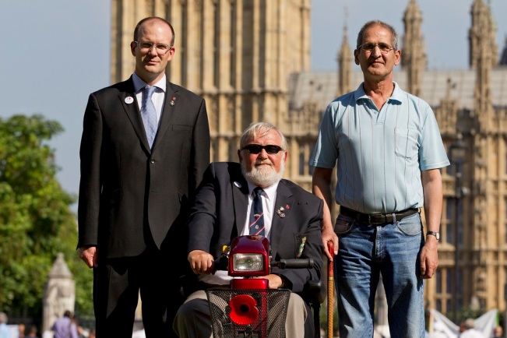
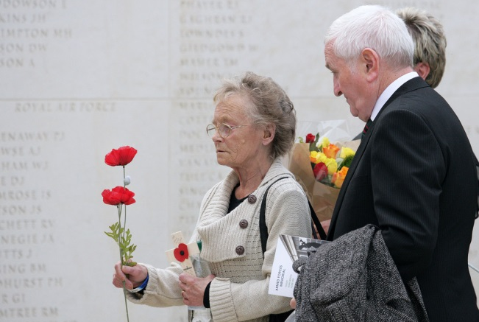
The Royal British Legion
Information & Support
Advocacy & Campaigning
Remembrance
Underpinned by:
Membership
Fundraising
Central Services

Slide 58
Examples - Breaks
Break Centres – hotel styled breaks to beneficiaries
Family Holidays –in either a Holiday Park or Break Centre
Adventure Holidays – Offered to children between 8 and 17
Poppy Pods - The Pods provide residential holiday/respite facilities for service personnel, veterans and their families.
Notes:
Mention waiting lists
Carers needs assessment – legal duty
‘Between 2007 and 2013, up to 11,000 serving members of the military were diagnosed with mental health conditions including post-traumatic stress disorder (PTSD) and depression. Many more suffer from existing conditions, go un-diagnosed and untreated’
(Centre for Social Justice, ‘Military Families and Transition’ Report, 2016)
PTSD – 4% same as population, though Reservist deployed 5-6%
www.kcl.ac.uk/kcmhr/pubdb
Veteran wanted support with having an assistance dog to help with his PTSD referral made to Service Dogs UK, dog now with individual and training on-going.
The rates of common mental disorders in deployed reservists are found to be higher.
1 in 4 (2015/16), 1 in 3 (2017) 18%-19.9%
Rates of PTSD the same but complexities generally greater
Adjustment disorder , Anxiety and Depression

Slide 59
Benefits, Debts and Money Advice
Support to those facing debt problems
Specialist advice and support to those dealing with complex benefit issues
Delivered face to face and over the telephone
Promote better money management.

Slide 60
War Pensions and Compensation
Specialist advice on War Pensions and compensation awards and deterioration claims, including entitlement and award disputes
Representation at Tribunal
Advice on merits of the case
Advice on supplementary allowances

Slide 61
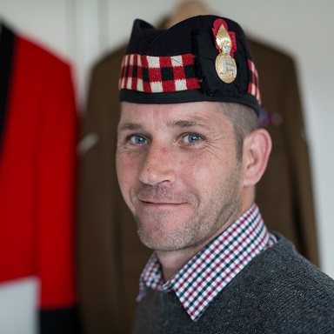
THE ‘ONE STOP SHOP’
for
ALL Servicemen, Servicewomen, Veterans and their Dependents
Who are in Need
Notes:
THE ‘ONE STOP SHOP’ for ALL Servicemen, Servicewomen, Veterans and their Dependents Who are in Need

Slide 62
SSAFA’S Mission
To relieve need, suffering and distress amongst the Armed Forces, veterans and their families in order to support their independence and dignity
Notes:
Our Values:
We are Understanding
We are Committed and Professional
We are Fair
We are Courageous
Our vision:
In recognition of their service to the Nation, SSAFA works to ensure that the needs of the Armed Forces, veterans and their families are met in an appropriate and timely way.

Slide 63
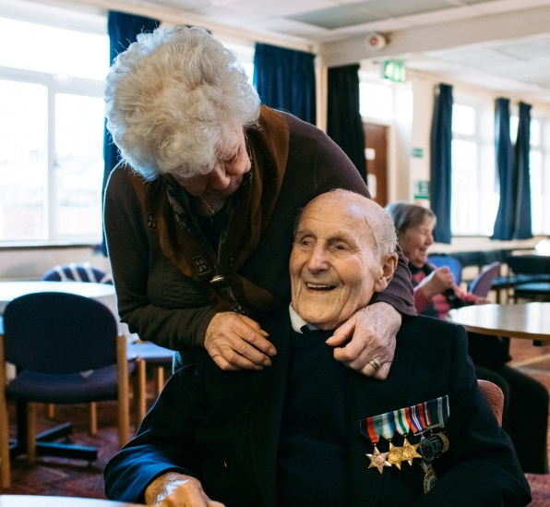
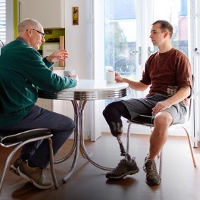
How we help
Practical, emotional and financial support for serving personnel, veterans and their families.
Including both regulars and reserves and anyone who completed National Service.
Notes:
SSAFA provides practical, emotional and financial support for serving personnel, veterans and their families.
Including both regulars and reserves and anyone who completed National Service.

Slide 64
What we Do
Our volunteer network provides:
Non-judgemental and friendly advice.
Welfare advice and support.
Housing and financial assistance.
Specialist services:
Mentoring.
Prison In-reach.
Independent Service Custody Visiting.
Notes:
We understand that being in the Forces is a unique experience. It can make it more difficult to cope with civilian life.
From unemployment to mental health problem – we can help with accessing a range of services.
We have a variety of support for ex-service men and women of all ages, including housing services and mentoring schemes, no matter how their circumstances might change.
In some areas we organise activities that combat isolation, such as veteran’s lunch clubs.
What makes SSAFA unique is our volunteer network and we deliver personalised support to those in need through a range of volunteer-led services.
We’re developing a preventative, early-intervention strategy to meet the changing beneficiary need, that will allow them to continue to maintain their independence and dignity.
Mentoring
We provide long-term. face-to-face support during and after transition. Our mentoring partnerships are also independent to the chain of command, so they complement the support people receive from their military unit.
We are starting a pilot in Catterick where we will offer transitional mentoring support to all service leavers.
Prison In-reach (PIR)
In line with SSAFA's commitment to provide lifelong support for our Forces and their families, some of our experienced caseworkers volunteer to undergo special training to engage with and support ex-serving personnel or members of their families in prison and/or on release. Support is also available for their dependants, and includes practical help such as the provision of essential household items and/or children's clothing, together with advice and information on matters like housing and resettlement. Neither cash grants nor legal support can be provided to prisoners, but branches may be able to signpost clients to the relevant organisations for specific support.
Independent Service Custody Visiting (ISCV)
This service provides independent oversight of military custody facilities in order to assure quality and professionalism of staff, provide transparency of the military detention process and most importantly to ensure that detainees are being cared for appropriately, and their health and welfare needs are met while in detention. A small number of volunteers from our network are being recruited and trained to fulfil this requirement in the UK based custody facilities for Army, Navy and RAF.

Slide 65
Notes:
THE ‘ONE STOP SHOP’ for ALL Servicemen, Servicewomen, Veterans and their Dependents Who are in Need

Slide 66
Issues Tackled
Social isolation
Debt
Relationship Breakdown
Housing
Self-Care
Addiction
Financial Hardship
Loneliness
Mental Wellbeing
Employment
Benefits
Transition
SSAFA Video
Notes:
We are seeing an increase in complexity of cases – no longer just one issue to deal with.
Our caseworkers need to signpost to multiple organisations for support.
Organisations require more evidence and detail from beneficiaries so the volunteer load is growing.

Slide 67
Contacts
Royal British Legion: 0808 802 8080
Veterans Gateway: 808 802 1212
SSAFA: Forces Helpline: 0800 731 4880
www. ssafa.org.uk
SSAFA Surrey: 01483 208111
surrey@ssafa.org.uk

Slide 68
Workshop and Case Studies
Case studies

Slide 69
What this means for you as a Service Champion

Slide 70
Being a Service Champion
Remember to ask ‘Have they served?’
Recognise the unique aspects of service life
Use the knowledge learnt on the course to better assist and support the needs of the Armed Forces Community
To be a point of contact to give advice and guidance

Slide 71
Spreading the word!
We need your help to share your learning with colleagues:
Need to ensure all front line staff are aware of the Covenant
Increase understanding of service life and issues faced
Raise awareness of additional sources of support
Encourage all to ask ‘Have you served?’
We will make it easy for you!!
Presentation and script provided within resource pack available after todays meeting
Notes:
As a Service Champion we would like to you take what you have learnt on this course and help spread the key messages to colleagues back in your workplace.
We will help you do this by providing you with a standalone presentation, and script, which summarise in about 45 minutes, the key learning from your training today.

Slide 72
Delivering the message – Tips!
Find some time at a Team Meeting or arrange a lunchtime briefing:
Be enthusiastic, maintain eye contact and keep to 1 hour
Keep informal with plenty of pauses to allow people to ask questions
Familiarise yourself with local resources
Use proforma to get people to sign in, and email the completed form to armedforces@surreycc.gov.uk
Encourage colleagues to take e-Learning via Surrey Skills Academy https://surreyskillsacademy.learningpool.com/
If you need support, contact other Service Champions, your Covenant Lead or email armedforces@surreycc.gov.uk
Insert Local Information
Notes:
Here are some tips that you may find useful:
Be enthusiastic, maintain eye contact and keep to time to 1 hour.
Keep it light and informal with plenty of pauses to allow people to ask questions
Familiarise yourself with local resources including the elearning module on the Covenant for Frontline Staff and any local leaflets
Use proforma attached to slide pack to get people to sign in, and email the completed form to armedforces@surreycc.gov.uk

Slide 73
Training and Contacts
E-learning
Frontline staff awareness training
Elected Councillor Armed Forces Champions Training
Surrey County Council Officer Contacts:
Sarah Goodman – armedforces@surreycc.gov.uk
Canon Peter Bruinvels – canonpeter.Bruinvels@surreycc.gov.uk
Chairman of SCMPB and Armed Forces Champion
Mr Peter Martin – chairmans.office@surreycc.gov.uk
Insert Local Information
Notes:
INSERT COUNTY OFFICER LEAD and Armed Forces Champion name and email

Slide 74
Resources
Websites
Veterans Gateway
Charities/COBSEO
E-resources
Pathways
Case studies
Notes:
Inset county council links – eg www.surreycc.gov.uk/armedforces
Pathways
In development
Your involvement
Education and Training
Employment
Housing
Mental Health
Physical Health
Rough Sleeping
Social Care
Alcohol and substance Misuse
Carers
Criminal Justice System

Slide 75
Notes:
Inset county council links – eg www.surreycc.gov.uk/armedforces
Pathways
In development
Your involvement
Education and Training
Employment
Housing
Mental Health
Physical Health
Rough Sleeping
Social Care
Alcohol and substance Misuse
Carers
Criminal Justice System

