Slide 1
Veterans Health
Johanna Hrycak
Armed Forces Covenant Project Manager for Milton Keynes, Bedford Borough, Central Bedfordshire and Luton councils.
Notes:
Slide in place when Michael Bracey (CE), Sam Crooks (Mayor) deliver short talks

Slide 2
Armed Forces Covenant
The Armed Forces Covenant is a promise from the nation ensuring that those who serve or who have served, and their families, are treated fairly.
“To those who proudly protect our nation, who do so with honor, courage and commitment, the Armed Forces Covenant is the nation’s commitment to you”
For more information email armedforcescovenant@milton-keynes.gov.uk
Notes:
Describe what a CMPB is
Discuss ours

Slide 3
AF Community
Those who serving
Those who have served
Reservists
Their Families
The bereaved
Cadet Instructors/volunteers
Divorced spouses
For more information email armedforcescovenant@milton-keynes.gov.uk
Notes:
Describe what a CMPB is
Discuss ours

Slide 4
AF Covenant
Focusses on helping members of the AF community have the same access to government and commercial services and products as any other citizen. This support is provided in a number of areas including:
Education and family well-being (School places)
Home owning Employment advice (Starting a new career)
Access to Healthcare (waiting lists)
Financial assistance (advice, inexperience)
Discount schemes
For more information email armedforcescovenant@milton-keynes.gov.uk
Notes:
Explain we are working towards Silver

Slide 5
AF Covenant
16th October press release
Notes:
Explain we are working towards Silver

Slide 6
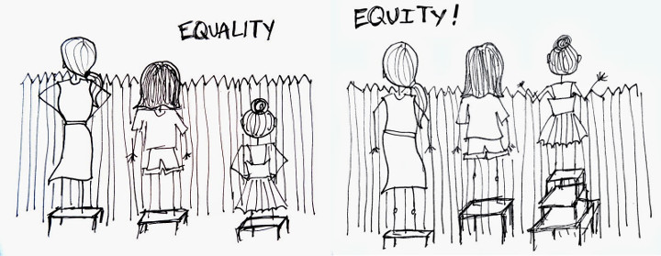
Armed Forces Covenant
For more information email armedforcescovenant@milton-keynes.gov.uk

Slide 7
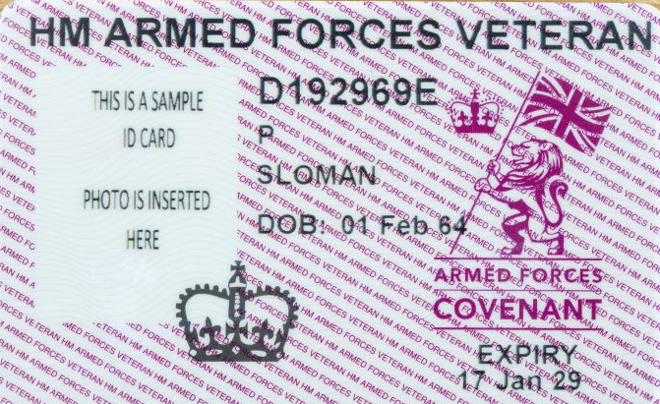
Veteran Population
2021 Census will provide new figures
Veterans ID card already being issued (Dec 2019)
More females
More young veterans
For more information email armedforcescovenant@milton-keynes.gov.uk
Notes:
Mon 24th June, Flag Raising at Civic offices. Over 250 people attended

Slide 8
Veteran Population
Barriers preventing veterans accessing services:
Military culture
Stigma towards MH
Negative belief about MH care
Identification of issues and seeking help
Transition into civilian life
For more information email armedforcescovenant@milton-keynes.gov.uk
Notes:
Mon 24th June, Flag Raising at Civic offices. Over 250 people attended

Slide 9
GP Veteran Gtrategy
Pilot: July 2018. Rolling out: now.
For more information email armedforcescovenant@milton-keynes.gov.uk
Notes:
Ooutline MK GP veterans project

Slide 10
BLMK GP Veteran project
To become accredited, GP practices need to:
have a Veterans Lead
identify veterans on computer system
undertake dedicated training
increase understanding of needs amongst clinical and administrative staff.
For more information email armedforcescovenant@milton-keynes.gov.uk
Notes:
Ooutline MK GP veterans project

Slide 11
Resources
Dr Thao Nguyen (Lt Col, Royal Army Medical Corps)
AFC Project Manager (SSgt Royal Army Medical Corps)
Information, literature & flyers – local events
Policy updates
Waiting room media
Veteran ‘drop ins’/clinics/events
AFC covenant signatories
For more information email armedforcescovenant@milton-keynes.gov.uk
Notes:
Local veteran engagement projects
Val Dixon

Slide 12
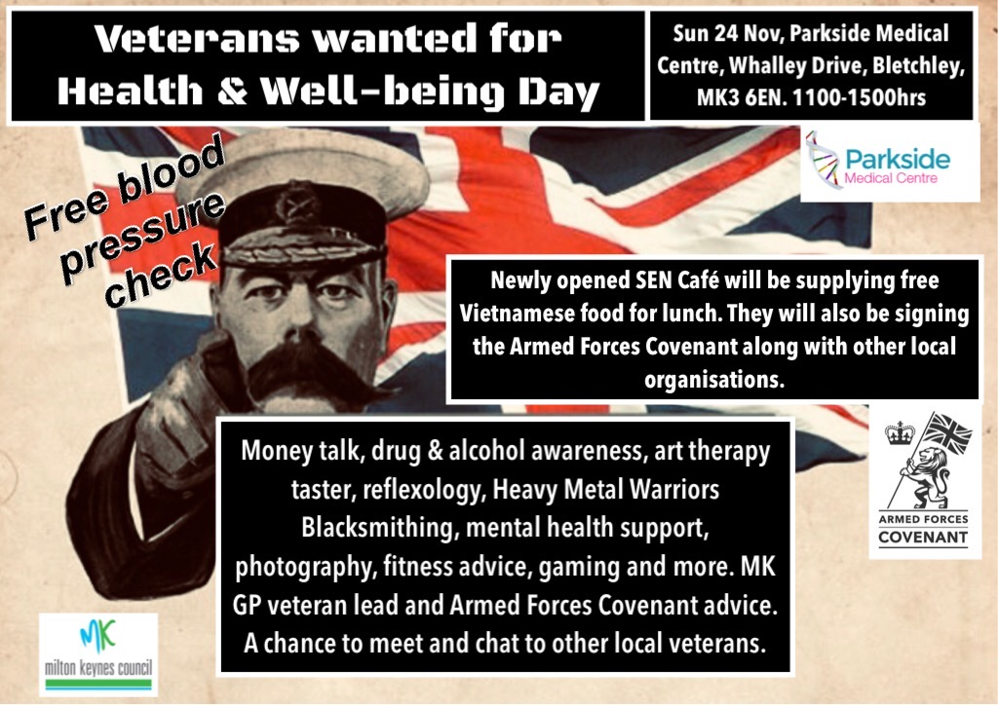
Resources
For more information email armedforcescovenant@milton-keynes.gov.uk
Notes:
Local veteran engagement projects
Val Dixon

Slide 13
Transition Intervention Liaison service
TILS - NHS mental health care for veterans
Contact TILS direct, GP referral or a military charity referral. Applicants must:
• be a resident in England and have served in the UK Armed Forces for a full day
• be registered with a GP in England /be willing & eligible to register with a GP
• provide military service number or another form of eligibility.
TILS works with a range of local organisations, including the wider NHS, charities, housing, employment agencies and social services, to ensure the appropriate support is in place for veterans & their families.
Service contact | Email | Contact number
Adele Stevens | sc.veterans@nhs.net | 0300 365 0300
Diane Palmer | mevs@mhm.org.uk | 0300 323 0137
MK (South Central TILS)
Beds (Midlands and East TILS)
For more information email armedforcescovenant@milton-keynes.gov.uk
Notes:
Explain we are working towards Silver

Slide 14
NHS Long Term Plan and Network Enhanced Services
The NHS long term plan includes the reduction in inequality of vulnerable people, including Veterans. One of the seven new National Network Enhances will address health inequalities:
“14. We will expand our support for all veterans and their families as they transition out of the armed forces, regardless of when people left the services. Local transition, liaison and treatment services provide support for a range of healthcare and social needs. By 2023/24, these services will expand access to complex treatment services as well as targeted interventions for veterans in contact with the criminal justice system. To ensure all GPs in England are equipped to best serve our veterans and their families, over the next five years we will roll out a veterans accreditation scheme in conjunction with the Royal College of GPs”
https://www.longtermplan.nhs.uk/
For more information email armedforcescovenant@milton-keynes.gov.uk
Notes:
Explain we are working towards Silver

Slide 15
Have you or a family member served in the British Armed Forces or Reserves?
The Armed Forces Covenant exists to ensure those that serve/have served receive the care they are entitled to. Additional support is available to those injured as a result of service & bereaved families.
“Have you served?”
Let your GP & reception know today!
Contact armedforcescovenant@milton-keynes.gov.uk for more information about veterans events, meetings and drop-ins in Milton Keynes.

Slide 16
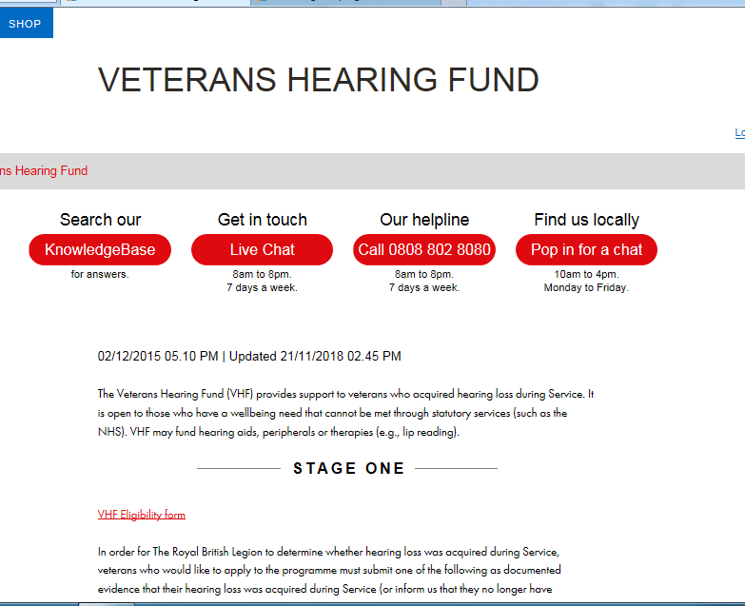
Resources available
Notes:
Introduce Amanda to say a few words

Slide 17
Hospital Scheme
Veterans Covenant Healthcare Alliance
37 hospitals nationally
GIRFT
MK, Bedford (L&D) all working towards
For more information email armedforcescovenant@milton-keynes.gov.uk
Notes:
Introduce Amanda to say a few words

Slide 18
Hospital Scheme
Veteran Aware hospitals:
Make info, including leaflets/posters, available to veterans & their families explaining what to expect
Train staff to be aware of veterans’ needs, that they should not face disadvantage and that special consideration is appropriate in some cases
Inform staff if a veteran or their GP has told the hospital they have served in the AF
Ensure veterans & their partners who have moved as a result of Armed Forces service do not lose their place on any waiting list
Signpost to extra services that might be provided to the AF community by a charity or service organisation in the hospital.
For more information email armedforcescovenant@milton-keynes.gov.uk
Notes:
Introduce Amanda to say a few words

Slide 19
Summary
Online training
Surgery sign up and veterans lead
Use mentors!
Attend training and engagement events
Understand NHS TILS service
Understand VAST signposting options
Veterans healthcare toolkit RCGP
Ask the question
“Have you served?”
For more information email armedforcescovenant@milton-keynes.gov.uk
Notes:
Introduce Amanda to say a few words

Slide 20
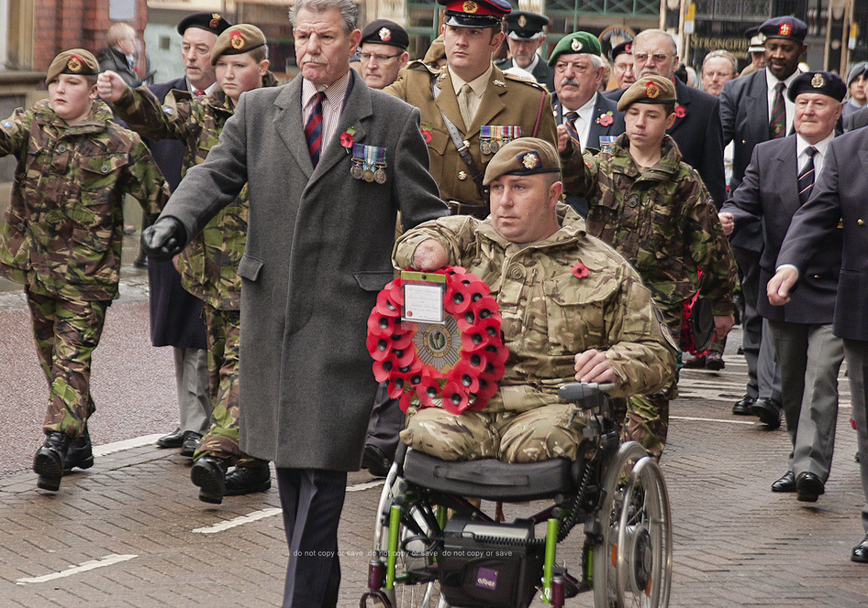
Questions
Notes:
Introduce Amanda to say a few words

