Slide 1



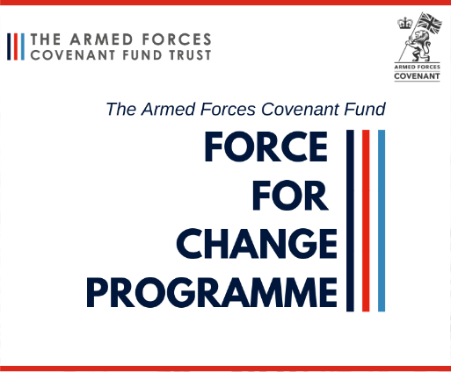


Building Sustainable Recovery for Veterans, Reservists & their Families through developing a Network of Trained ‘Veteran Peer Mentors’
Registered Charity: 1191970
Dr Gillian Le Page
Mobile: 07902632949
email: veteran8011@gmail.com
Website: vcn.org.uk
Supported by Milton Keynes Council & Bedford Borough Council

Slide 2
What is our AIM?
To Be:
Aspirational
Inspirational
Motivational
Through Co-Production and Veteran Peer Mentoring

Slide 3
What is Peer
Mentoring?
- Has Military Service in common
- Understand comradeship/ the military family & identity
- Are uniquely placed to help other veterans
experience of a significant life event
developed skills to help them cope, adjust, recover and thrive
willing to share this knowledge or ‘lived experience’
stable in their own recovery (if been through treatment)
through offering informal support, act as ‘beacons’ of recovery
inspire and motivate others to seek help

Slide 4


Peer Mentor Training OCN Accredited
Assessments
Record keeping/Case Management
Active listening
Substance awareness
Confidentiality /data protection
Boundaries
Safeguarding (vulnerable adults and children) & Prevent
Enhanced DBS
Supervision
+ 2 day veteran mental health first aid

Slide 5
Provide peer mentor support to veterans & reservists by:
Provide peer mentor support to families by:
Assertive outreach
Motivating veterans to access treatment using self-help psychosocial interventions
Re-connecting with veterans who have dropped out of treatment
Encouraging veterans to remain in treatment
Care co-ordination by connecting veterans to other support services
Advocacy
Facilitating support groups
Raise awareness of the impact of mental health and / or substance misuse on daily living & family life
Facilitate learning of strategies to improve family life
Advocacy
We NEVER just Signpost !

Slide 6
Peer Mentoring Activity
Since VCN began in November 2019 we have supported over 150 veterans, reservists and family members across Milton Keynes, Bedfordshire and Northamptonshire
Support has included:
motivational psychosocial self-help to support veterans to engage in formal treatment
  Onward referral to partners including RBL, SSAFA, TILS, RFEA, Models4veterans, Housing, Drug and Alcohol services, Project Nova, GP referrals
  Taking veterans to appointments, assertive outreach to facilitate engagement with partners, providing emotional support for veterans/reservists & family members who are shielding and arranging essential deliveries such as prescriptions.
  Advocacy to ensure fair access to treatment and support

Slide 7
Veteran Testimonials
After hitting my all time lowest I have ever been in my entire life VCN has been the help I never thought I deserved.
I’ve been suffering with my mental health for some time now & after reaching out to the RBL they but me in touch with VCN. We phoned on a daily basis to start with & the help/support that I’ve been given has really made me see my self worth & that I am not alone. VCN continues to talk with me and follows up with texts to check in. Without the help and support from VCN, I don’t even want to start to think where I would be right now. I am only just starting off on my journey and I know its going to be a long one but VCN is there with me. Thank you, I really can’t thank you enough.
JT 6/7/20
Joint working with RBL & TILS
Having a point of contact in your local community who can support you in key areas networked to services or professionals who have experience in military affairs is a life saver.
Milton Keynes/Bedford Veterans Community Network is a fantastic idea and I'm very grateful to have them supporting me. Ian 2/7/20
Joint working with Housing, RBL & TILS
The help I've received from VCN has been invaluable, despite not being fully aware that I needed help. It was suggested that I may benefit from a chat with VCN and I did and through regular contact VCN has prevented me from spiralling into a deep depression. SB 3/7/20
Joint working with Dreamsai Milton Keynes (Food parcels during lockdown)

Slide 8
Case Studies
Veteran referred by police for support following a Sec 136.
Left Army in 2001 because of PTSD. Not previously sought help
Service related PTSD, self harming, suicidal thoughts and alcohol abuse
Since Oct 2020 VCN Support included:
  Referral to TILS / alcohol service
  Advocacy with psychiatric service & police including attending appointments, being a ‘responsible adult’ in police custody and McKenzie friend in a family court case
  Support to access benefits
  Support with social isolation/daily contact
  Outcome: veteran is more stable, engaging in treatment and waiting to commenced a Residential Programme (Tom Harrison House) on 20/03/21
Veteran referred to VCN by the local Complex Treatment Service.
Diagnosed with complex PTSD, it was a struggle to engage and keep appointments
VCN has worked with the veteran and made referrals to RBL for support with debt
Liaised with local MH services and followed up with an ADHD assessment which the veteran had started back in 2019 but dropped out of treatment due to anxiety issues and wanting to avoid a diagnosis of ADHD as there was concern this would impact employment
Supported the veteran in addressing drug addiction and understand the relationship between drug use and ADHD
After 4 months support, there is an improvement in attending appointments and a reduction in drug use. Support is on-going

Slide 9
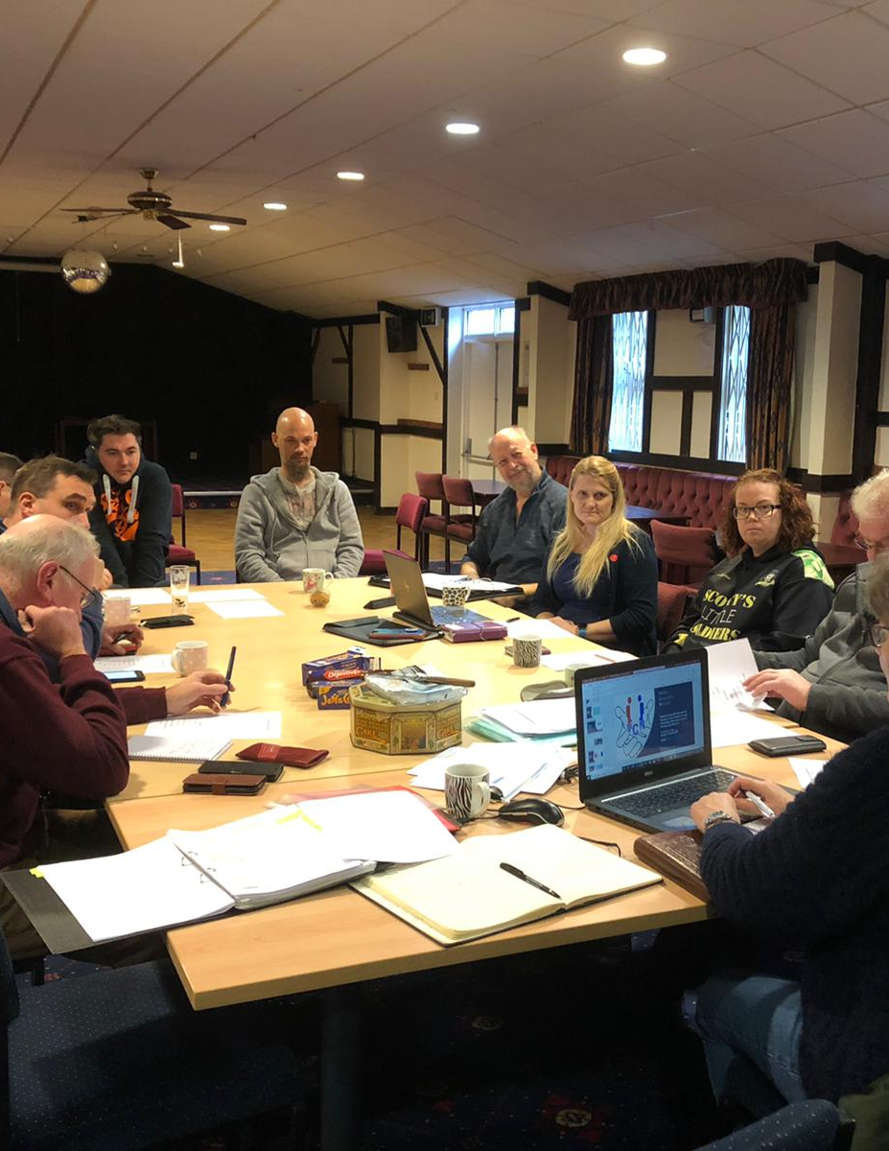
CO-PRODUCTION MODEL
VETERANS / RESERVISTS / FAMILY MEMBERS AT THE HEART OF ALL WE DO:
  Supported by:
    Stake Holder Group
    Board of Trustees

Slide 10
What else will the
Veterans Community Network do?
Hub Outcomes
First Drop-in Outcomes
- 19 Professional Agencies attended and gave a 5 minute presentation
- 55 veterans attended
Set up in partnership with national and local veteran services / charities, a monthly veteran / reservist and family drop-in
THE DROP-IN WILL REOPEN AS SOON AS COVID RESTRICTIONS ALLOW

Slide 11



















VCN Drop-in Hub Delivery Partners
OP
COURAGE
MKC
HOUSING OPTIONS
Community Outreach across MK
VCN
Bletchley HUB
One
Stop
Shop
Veterans Reservists & Family Support
ARC
CNWL MH SERVICES
HEAVY METAL WARRIORS

Slide 12

Testimonial from Anna De Rocha (VETS UK)
very well organised and well received.
learned a lot about other organisations and other valuable resources.
had 8 new referrals
one client I saw should get 5 years backdated Council Tax!
great result in my eyes at only the 1st event.

Slide 13
Testimonial from John Phillips
(Project Nova)
I attended the inaugural VCN meeting, the organisation and planning was outstanding
As a direct result of that first meeting, our organisation saw a significant increase in referrals and collaborative working.
The liaison and networking opportunities, proved to me what a valuable and essential service the VCN provides.
I found housing options, employment opportunities, mental health provision, probation services, Police services and drug/alcohol team contacts directly as a result of that one meeting.
I cannot speak highly enough about the fantastic work they are doing for veterans’ in the community.
The VCN team are dedicated, professional and conscientious in helping veterans’ and Project Nova are better for knowing them and we look forward to many years of collaborative working to help veterans’ in the future.

Slide 14
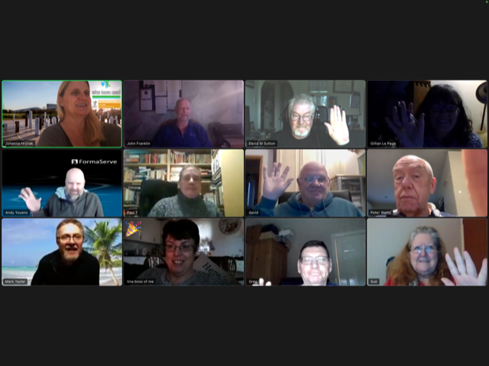
FORCE FOR CHANGE GRANT : 2021/22: Tackling social isolation in the COVID 19 Pandemic
In partnership with MK/Bedford Borough Council
MK & BEDS Only
Virtual Hub
Tea & Banter
Quiz, games, brain teasers
Invited speakers
SITREP

Slide 16
How to make a referral
Call us on 07902632949
We need
  Name
  Contact details
  Reason for referral
  Documented signed consent

Slide 17
Apply for Service Standards
Accreditation
Peer mentor training accredited with OCN Credtit4Learning / on-going membership.
PHE accredited veteran MH First Aid Training
The NCVO Mentoring and Befriending’s Approved Provider Standard
Membership Association of ex-Service Drop-in Centres- ASDIC Framework
Membership of COBSEO, The Confederation of Service Charities

Slide 18
Registered Charity: 1191970
Thank you
Supported by Milton Keynes Council & Bedford Borough Council

