Slide 1
Slides that need local information, speaker notes and logos
2, 4, 7, 17, 18, 22, 23, 24, and 33

Slide 2
Customer Facing Staff Training Notes and Presentation
Developed by
Canon Peter BRUINVELS
PETER BRUINVELS ASSOCIATES
Insert local authority logo

Slide 3
Customer Facing Staff Training
Congratulations on completing your Armed Forces Service Champion Course. This pack has been developed on behalf of Forces Connect South East to enable you to easily share the key learning from your training course with your colleagues back in your organisation. All Service Champions are being asked to help promote the message, so it is not just down to you, but we would appreciate your help sharing the key messages with your team members.
This pack contains a powerpoint presentation with full scripted notes for your to use. It should take about 45 minutes to run through. Please share appropriate material and links from the resource pack you have access to from your Service Champions Training.
As part of the requirements of the Forces Connect SE project, we need to record the number of people who have been trained on the Covenant and report this back to the Ministry of Defence. Please could you encourage all attendees at your training to fill in the proforma (please print it out before you start!) and scan the form and email it back to armedforces@surreycc.gov.uk
If you have any queries, please contact your Covenant Lead in the first instance (see next page) or email armedforces@surreycc.gov.uk and they will help you or point you in the right direction.
Thank you very much for helping to ensure that public authority staff are aware of the issues facing Armed Forces Community and know how to support them.
Many thanks
Canon Peter Bruinvels

Slide 4
Your Local Authority Contacts
Area | Councillor |  | Officer
Elmbridge | Cllr Barry Cheyne | bcheyne@elmbridge.gov.uk | Derrin Gill | dgill@emlbridge.gov.uk
Epsom and Ewell | Cllr Martin Olney | molney@Epsom-ewell.gov.uk | Serena Powis | spowis@Epsom-ewell.gov.uk
Guildford | Cllr David Elms | David.elms@guildford.gov.uk | Steve Benbough | Stephen.Benbough@guildford.gov.uk
Mole Valley | Cllr Alan Reilly | councillor.reilly@molevalley.gov.uk | Lucy O’Connell | Lucy.oconnell@molevalley.gov.uk
Reigate and Banstead | Cllr Graeme Crome | Cllr.crome@Reigate-Banstead.gov.uk | Vacant
Runnymede | Cllr Tom Gracey | Cllr.tom.gracey@Runnymede.gov.uk | Suzanne Stronge | Suzanne.stronge@Runnymede.gov.uk
Spelthorne | Cllr Robin Sider | Cllr.sider@Spelthorne.gov.uk | Michael Graham | m.graham@Spelthorne.gov.uk
Surrey Heath | Cllr Colin Dougan | Colin.dougan@surreyheath.gov.uk | Jayne Boitoult | Jayne.Boitoult@surreyheath.gov.uk
Tandridge | Cllr Pat Cannon | Cllr.Patrick.cannon@tandridgedc.gov.uk | Chailey Gibb | cgibb@tandridge.gov.uk
Waverley | Cllr Maurice Byham | Maurice.Byham@waverley.gov.uk | Louise Norie | Louise.norie@waverley.gov.uk
Woking | John Kingsbury | john.Kingsbury@woking.gov.uk | Zafar Iqbal | Zafar.Iqbal@woking.gov.uk
Surrey | Mr Peter Martin | Chairmans.office@surreycc.gov.uk | Sarah Goodman | armedforces@surreycc.gov.uk
Insert Local Information
Notes:
These are the names and contact details of your Local Armed Forces Champions by Borough and District

Slide 5
Before you start, here are a few Top Tips for you as a Trainer!
Work closely with Lead Covenant Officers / Service Champions
Develop a personal relationship with Armed Forces Champions and brief them on issues raised
Share best practice with other Departmental Leads
Promote ‘App’ and One Stop Signposting Leaflets
Train up to 20 in any one group / Maintain eye contact
Keep to time and keep it light with plenty of pauses
Record names and departments of all attending
Keep PBA aware of any major issues raised
Be enthusiastic and energetic in your talk
Good luck, and remember we are here to help!
Notes:
I want you to enjoy delivering the course!

Slide 6
Training Log – Front Line Staff
As part of the requirements of the Forces Connect SE project, we need to record the number of people who have been trained on the Covenant and report this back to the Ministry of Defence. Please could you complete your details below, scan the form and email it back to armedforces@surreycc.gov.uk
Name | Job Role/ Dept
Name | Job Role/ Dept
Training delivered by:
________________
Please scan and email
to:
armedforces@surreycc.gov.uk
Notes:
An example of the proforma for your information – as you will see we do need names, job roles and department – this helps us with the new GDPR coming in!
We also need your name as the Trainer and the total number attending.
Please complete and return to armedforces@surreycc.gov.uk

Slide 7
Customer Facing Staff Training
Delivered by
Canon Peter BRUINVELS
PETERBRUINVELS ASSOCIATES
Insert local authority logo

Slide 8
Welcome, aims and objectives
Why are you here?
What is the Armed Forces Covenant?
How you can support the Armed Forces Community?
Who are the Armed Forces Community?
Where are the Military in your Area?
How we can understand their needs?
How you can get closer to them and strengthen the links?
Provide you with the knowledge and capability to strengthen your role as Customer Facing Staff
How to work with AFCs/Covenant Officers / Service Champions
Linking with Service Charities and how they can help?
FCSE and other sources of Training, including e-Learning
Your experiences so far of working with Military
Top Tips
Questions and Answers from the Floor
Notes:
Really pleased to be welcoming you here today.
This Training Course is funded through an MoD Covenant Grant and brought to you through Forces Connect South East by Canon Peter Bruinvels from PETER BRUINVELS ASSOCIATES, whose slides I am using.
I have recently attended the Service Champions course and I am here now to present this course to as many front-facing staff in the County.
Here it is the outline of the 45 minute course
By attending today, it will help you understand the needs of the Military and their issues
Who they are
And how you can help them!
You are very much the first point of contact
You know already that you are Ambassadors for the Council
When they phone in or come to Reception, you need to welcome them and of course, ask whether they served. This course will show you why it is important
Do it subtly
You can help shape their future

Slide 9
Aim of the Training
Promote the Armed Forces Covenant
Instil Staff Commitment
Embed the Covenant within ways of working
Ensure all Council Help Desks/ Contact Centres know about the Armed Forces Covenant
Ensure Local Authority Staff are aware of the issues facing Armed Forces Personnel, their families and Veterans
Ensure all Staff ask “have you served?”
Notes:
The Aim of today’s Training.
We will be promoting the Armed Forces Covenant – see the next few slides
Tying you all up to it
Seeing how the Covenant helps the way we work
I am going to explain what is the Armed Forces Covenant as well as some of the issues affecting the Armed Forces Community.
It will be probably the first time that they have contacted their Local Council and we want it to be a good experience for them.
NB The only way that we will know if they are Military or Ex-Military is if you ask them “Did they serve?”

Slide 10
The Armed Forces Covenant
The Armed Forces Covenant is a promise from the nation ensuring that those who serve or who have served, and their families, are treated fairly.
“To those who proudly protect our nation, who do so with honour, courage and commitment, the Armed Forces Covenant is the nation’s commitment to you”
“Parity not priority”
Notes:
Let’s talk through what the Covenant means.
The next few slides give details as to what it means, obligations and what is being done to help members of the Armed Forces Community
Who is being involved?
How the Covenant has benefitted the Armed Forces Community
The Covenant is a promise from the Nation……..to those who serve(d) ….to be treated fairly.
“Parity, not Priority”
This means that they are NOT given an advantage over any non-Service family,
……but, that they will be treated the same as anyone else.

Slide 11
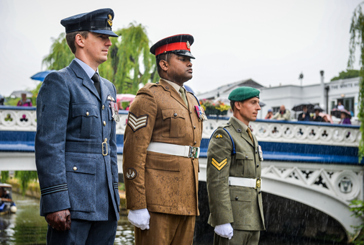
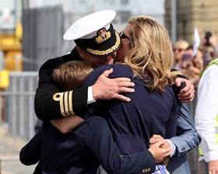
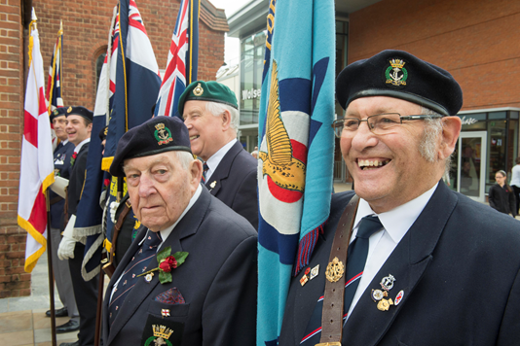
Who are the Armed Forces Community?
Notes:
Examples of the Armed Forces Community.
They come from the:
Royal Navy (RN), Royal Marines, Army and Royal Air Force (RAF)
Young and old
Regulars (Serving Personnel), Reservists and Veterans
Service Families
Service Children
You are a Veteran after 1 day’s service!
We know of Veterans aged 18 and 105!

Slide 12
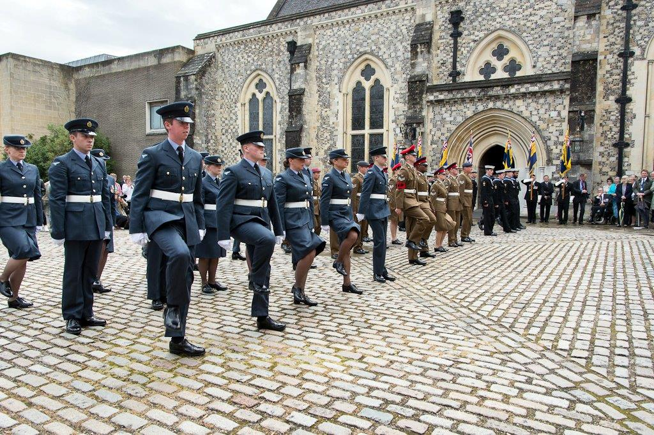
Armed Forces
Tri-Service on Parade
Notes:
A typical Public Military Event in Winchester
NB 6 week’s minimum notice to 11 Brigade SE and the Police , if you are holding an event involving the Military.

Slide 13
What is being done?
The Covenant focusses on helping members of the armed forces community have the same access to government and commercial services and products as any other citizen.
This support is provided in a number of areas including:
Education and family well-being – school places
Home owning
Employment advice – starting a new career
Access to Healthcare – waiting lists
Financial assistance
Discount schemes
Notes:
The issues affecting the Military are the same as many of us:
Difficulties in getting their children into a local and popular school
Having enough money to buy their first house
Starting a new career after years of military service and military life
Getting on a GPs waiting list
But unlike civilian life – they do not know who and where to ask for help and advice.

Slide 14
Who is involved?
Central Government
Royal Navy, British Army, Royal Air Force
3,000+ Businesses of all sizes
Local Government
Service Charities
Communities
Cadet forces and their adult volunteers
www.armedforcescovenant.gov.uk
Notes:
As you can see so many public bodies, businesses, Local Authorities, Service Charities are involved
Everybody!

Slide 15
Civilian-Military Partnership Boards
Provide a strategic link within partner organisations with regard to the Armed Forces Covenant
Give strategic direction in order to strengthen links between communities and the Military
Champion the Armed Forces and honour the commitment given by the men and women of the Armed Forces
Review the work of the Armed Forces Covenant on an annual basis
Acknowledge and promote the valued role Reservists play within the community
Encourage recognition and remembrance of the role played by the Armed Forces
Work collaboratively with the task groups and act as final arbiter
Notes:
Every County Council and both Unitary Authorities with FCSE has a Civilian-Military Partnership Board in some shape or form.
They are normally chaired by the Armed Forces Champion:
Surrey Civilian-Military Partnership Board is chaired by Cllr Peter Martin*
The main topics and issues raised at Civilian-Military Partnership Boards centre around:
Remembrance
Spousal Employment
GP and Dentist Waiting Lists
Service Children and Admissions (Mid-year / mid-term),
Housing Waiting Lists
*Chairman of their County Council as well

Slide 16
Armed Forces Personnel Restructure
38,000
2,930
2010
2015
2020
29,710
2,190
Regular
Reserve
30,600
3,100
104,000
19,000
2010
2015
2020
82,000
22,000
82,000
30,000
29,415 (2019)
42,500
1,500
2010
2015
2020
31,250
1,740
31,750
1,860
Notes:
Following a recent restructuring including Army Refine 2020, these are the latest figures for Armed Forces Personnel.
All three Services are down in numbers for Regulars and increasing for Reserves as part of that planned restructuring, there are currently vacancies in all three Services.
Women 100 (9.6%) and BAME Initiatives underway.
NB 4,000 Regulars are returning from Germany to Salisbury in 2019
11,000 MoD Civil Servants *70,000 Army Cadets
5,500 vacancies in the Army.
Key word ATTRACT rather than RECRUIT
In 2017, 51,726 were deployed to 55 Countries under Defence Engagement.
In 2018, we have been on 27 Ops to date!

Slide 17
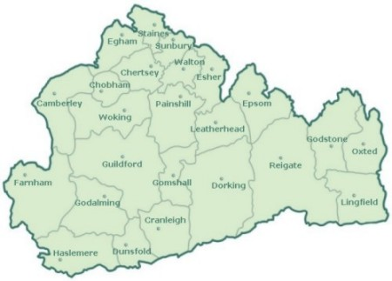
Military Presence In Surrey
Insert Local Information
Regular
Reserve
Notes:
Surrey’s Military Presence with 4 Task Force Commanders who come under the direct command of 11 Infantry Brigade SE.
A Task Force Commander is a senior Commanding Officer whose Unit is linked to three / four Local Authorities as part of the MoD’s Community Engagement Initiative
Surrey is home to DMRC Headley Court in Leatherhead, Army Training Centre (Pirbright), Royal Logistic Corps in Deepcut, the Royal Army Medical Corps in Keogh and the Royal Military Academy Sandhurst.
Reserves are 4 Princess of Wales’s Royal Regiment; 135 Geo Sqn Royal Engineers and 579 Sqn EOD Royal Engineers.

Slide 18
Armed Forces Community
SURREY | Now | Changes
Regular Army ARMY REBASING 2020 REFINE | 6200 Serving military 680 Military Families (1265 service children in 184 Surrey Schools) Royal Alexandra / Gordons £300 Premium) | 1Welsh Guards-Windsor 2019 4 Armed Medical Regt Tidworth 2019 22Field Hospital Nuneaton 2020 27 Regt RLC Catterick 2021 DMRC Headley Court closes in 2018 Deepcut closes in 2019 ATC Pirbright/Keogh Barracks
Army Reserve | 250+ | 2 Pl A Coy 4 PWRR FARNHAM 4PWRR HQ REDHILL April 2018 2Trp 579 Field Sqn 101 EOD REIG 135 Geo Sqn RE - EWELL
Cadets: ACF CCF | 27 Detachments (750) 12 Contingents (1200) 192 Cadet Adult Vols | Royal Alexandra & Albert School Ash Manor CCF (Grenadiers) NB Sea Cadets: 8 ATC: 12
Service Leavers | 8000 pa (Army) 10% to settle in SE | 50% have no idea where 50/100 in Surrey per annum
Insert Local Information
Notes:
18
Surrey has some upcoming major changes with DMRC Headley Court closing in Autumn 2018 and the facilities moving to the Midlands
And Royal Logistic Corps (RLC) Deepcut moving in late 2019 / 2020 to Worthy Down, Hampshire
You will notice that the Welsh Guards are going to Windsor; 22 Field Hospital to Nuneaton;
4 Armoured Medical Regt to Tidworth and 27 Regt RLC to Catterick
We are still waiting to hear which units will take their place
Many service people are living outside the county
Others are serving outside the county in Aldershot, Portsmouth, RMA Sandhurst and Tidworth as well as MoD Main Buildings, London SW1
Cadets though large in number are not part of Armed Forces Covenant but do form part of the wider armed forces community

Slide 19
What is Different about the Armed Forces Community?
Moved around the country/abroad, often at short notice
Geographically isolated on military bases
Isolated from family support networks
Strong sense of pride and not wanting to ask for help
Provided with Service Family Accommodation
Not used to accessing local authority and other public services
Lack of postcode on Bases
Notes:
As you can see the Military move around regularly and often at short notice.
Their lives are very different from ours!
They are not used to asking for help and in many cases do not understand how to!
Very proud!
I am pretty certain that they have probably never been to a Council Office.

Slide 20
What impact this has on Armed Forces Families
Education:
Access to school places/school transport/curriculum
Access to Health Care/Benefits:
Asking for help
Waiting lists for doctors/dentists
How to access to Social Services/Benefits
Employment:
Impact on spouses job prospects – gaps in CV
Jobs on leaving the Service
Housing:
Waiting lists
Notes:
Again – some of their issues are the same as ours.
Trying to get their child into a school of their choice
Getting onto their local GP’s / Dentist’s waiting list
Except – that we know who and where to ask
Military Spouses do find it hard to get appropriately employed as to uncertainty of the length of postings (many spouses are overqualified) – gaps in their CV’s

Slide 21
Impact on Adult Social Care
Some issues that Veterans present with could be a result of their Service
Additional support available for Veterans
Those who served for a day
All males 75+ (National Service finished in 1960)
Possible issues Veterans present with:
Disability
Mobility
PTSD
Mental Health
Alcohol Issues
Debt
Loneliness
Notes:
Adult Social Care provides front line caring.
But we need you to ask at the contact centre – did you or your partner serve?
If they say that they or their partner ‘only did National Service’ – then that means that they served and that they qualify for support from Service Charities
SSAFA regularly undertake Casework for us in this way
We would encourage you to refer clients who have served in the Military to your County SSAFA Branch to see if they are entitled to any additional support in addition to the support that the local authority can provide – contact details are later on in the presentation.

Slide 22
What Surrey is doing to help?
Established the SCMPB to bring partners together to address issues
Awareness of Service Charities with Services especially Adult Social Care
Relationship between Admissions and 11 Brigade over planned moves
Link to Career Transition Partnership for vacancies
Support to Reservists working for Surrey
Helping to attract Cadet Adult Volunteers
Insert Local Information
Notes:
Surrey is on to the case:
Major issues identified and actioned such as excellent communication links developed between the Army and school admissions, with the Army planning new tours in line with the start of the school year where possible to help with school admissions
Career resettlement advice and mentoring
An up to date and sympathetic HR Reservist Policy and a dedicated HR team committed to supporting Reservists working for Surrey CC
PR initiatives to celebrate and encourage staff to volunteer as Cadet Adult Volunteers
Annual Reserves Day
Surrey hold the MoD Employers Recognition Gold Award

Slide 23
AFC Veteran Population
County | Number to nearest ‘000 | Percentage of County population that are veterans
East Sussex | 36,000 | 5%
Hampshire | 90,000 | 6%
Kent | 73,000 | 5%
Surrey | 42,000 | 5%
West Sussex | 42,000 | 6%
Insert Local Information
Notes:
283,000 Veterans in the South East
This equates to approximately 5.5% of the Population.
Hampshire has the most in the region – Surrey and West Sussex have approximately 42,000 veterans. The issue is we don’t know who or where they are, which is why it is so important to ask when people are accessing our services.
In 2021, there will be a question about Veterans and whether they served as part of the ONS National Census.
Here is the link:-
https://www.gov.uk/government/statistics/annual-population-survey-uk-armed-forces-veterans-residing-in-great-britain and https://www.gov.uk/government/statistics/location-of-armed-forces-pension-and-compensation-recipients-2018

Slide 24
AFC Veteran Population
SURREY Local Authority | AFPS | War Disablement Pension
Elmbridge | 235 | 119
Epsom and Ewell | 100 | 69
Guildford | 590 | 217
Mole Valley | 201 | 97
Reigate and Banstead | 266 | 147
Runnymede | 168 | 72
Spelthorne | 192 | 109
Surrey Heath | 693 | 167
Tandridge | 178 | 111
Waverley | 243 | 187
Woking | 93 | 78
Insert Local Information
Armed Forces Pension and Compensation (AFPS) Recipients
Notes:
The table sets out the numbers in Surrey by Local Authority claiming under the Armed Forces Pension and Compensation Scheme.
The Armed Forces Compensation Scheme (AFCS): provides compensation for any injury, illness or death which is caused by service on or after 6 April 2005.
The War Pension Scheme (WPS) compensates for any injury, illness or death which occurs up to this date.
The AFCS is a no-fault scheme which means payment is made without admitting fault.
2.1 Who is eligible?
All current and former members of the UK armed forces, including reservists, may submit a claim for compensation. Unlike the War Pension Scheme, you can submit an AFCS claim while still serving, as well as after you have left the armed forces. While there are time limits, above all you should submit a claim for compensation at a time which is best for you. In the event of service related death, the scheme pays benefits to eligible partners and children. An ‘eligible partner’ is someone with whom you are cohabiting in an exclusive and substantial relationship, with financial and wider dependence.

Slide 25
How you can help us on the Front Desk / Reception / Contact Centre
Find out if the Caller / Customer (or their spouse) has served
Know your way around the Support for Armed Forces Community Web Pages and our App
Signpost to Service Charities/use CC/ Surrey Information Point
Alert us to trends/repeat issues so these can be addressed upstream
Notes:
Your role on the Front Line.
You are often the first point of contact for the member of the Armed Forces Community.
The Armed Forces Community are approaching you probably for the first time. They really need your help
Please ask them whether they or their partner has served.
Use the support available:
Website – www……..gov.uk/armedforces then click on sources of support
Referral pathways are in the process of being developed, which will be put on the website when available.
Make sure you signpost to SSAFA if someone needs additional support that local authorities are not able to provide
If you note any trends or repeat issues, please let us know by emailing armedforces@..............gov.uk so we can address these upstream.

Slide 26
Service Charities
RBL
The Royal British Legion is a leading Service Charity providing lifelong support for the RN, British Army and RAF serving men and women, veterans, and their families 24/7 www.britishlegion.org.uk
0808 802 8080
SSAFA
The Armed Forces Charity supports Regulars and Reserves from all three Services and their families. A caseworker organisation, they visit the Client’s home
www.ssafa.org.uk/armed-forces
0800 731 4880
COBSEO
www.cobseo.org.uk
Notes:
Two major Service Charities ready to help 24/7 – these are SSAFA and the Royal British Legion.
There are more than 2500 other Service Charities!!
SSAFA offers trained Caseworkers covering every Local Authority who will visit the Client in need in their own home – their contact details are on the screen – please make a note.

Slide 27
Additional Help Available for Veterans
Veterans’ Gateway: Single point of contact for veterans seeking support www.veteransgateway.org.uk
Other Key Service Charities:
Royal Naval Benevolent Trust www.rnbt.org.uk
ABF The Soldiers’ Charity www.soldierscharity.org
RAF Benevolent Fund www.rafbf.org
Potential Help Available:
Mobility aids, white goods, care home fees, home adaptations, financial assistance etc
Notes:
There are over 2500 Service Charities and Regimental Associations in the country.
These are the top service charities locally in addition to SSAFA and RBL.
Veterans’ Gateway is a Covenant funded initiative and offers a single point of contact for those unsure of which charity to go to – again please take note. All contact details are available via their website.
Typical welfare help is as above.
NB. But most claimants are means tested and they need to have under £16,000 in savings to be eligible.

Slide 28
Armed Forces Champion for the County Council, Borough and District
Job Description: A Councillor with an interest in the Armed Forces Community. Some Armed forces experience would be an advantage.
Aim: To raise the profile and needs of the Armed Forces community (serving personnel, both regular and reserve, their families, veterans and Cadets), internally and externally with the County/ Borough/District council.
Ensure all areas of Council Policy/business take into account the needs of the Armed Forces community (education, housing, welfare, health and employment).
Ensure that Members and Officers are aware of
forthcoming military ceremonial events
Encourage and support local applications to the
Armed Forces Covenant Grant Fund
Notes:
Each local authority including County Council and Unitary Councils has a Councillor Armed Forces Champion who help to raise the profile and needs of the armed forces community both locally and within the local authority.
The slide sets out the key aspects of their role.
There are 25 Task Force Commander in 11 Infantry Brigade SE
69 Armed Forces Champions (AFCs)
Forces Connect South East:
12 AFCs in Hampshire
14 AFCs in Kent (includes Medway)
12 AFCs in Surrey
8 AFCs in West Sussex
7 AFCs in East Sussex (includes Brighton & Hove)
The Armed Forces Champions work closely with a local military unit, as well as the officer Covenant lead within the authority.
I have their names and contact details if you would like them. They are here to support us and our residents.

Slide 29
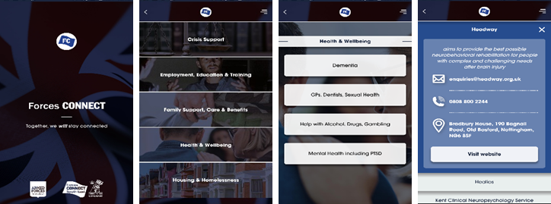
Forces Connect SE Signposting App
Available for free to download. Search ‘Forces Connect’ in your app store now!
Signposting and connecting the entire Armed Forces Community as well as public sector/
not-for-profit practitioners in the
South East to the right services for
support and advice.
Using data from the NHS Armed
Forces Networks Referral Pathways.
Commissioned by Forces Connect South East and developed by Kent County Council and the Wow Factory.
For more information contact: FCSE@surreycc.gov.uk
Notes:
This new signposting App was launched at Surrey Armed Forces Network Conference – AMEX Centre, Brighton in January 2019
Developed by Kent CC and produced by The Wow Factory
It has been very well received across the South East by Local Authorities and the MoD
Available on Apple and Google Android devices under ‘Forces Connect’.
Why not try it out - NOW

Slide 30
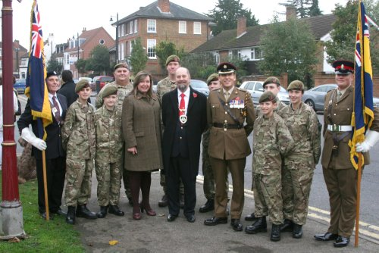
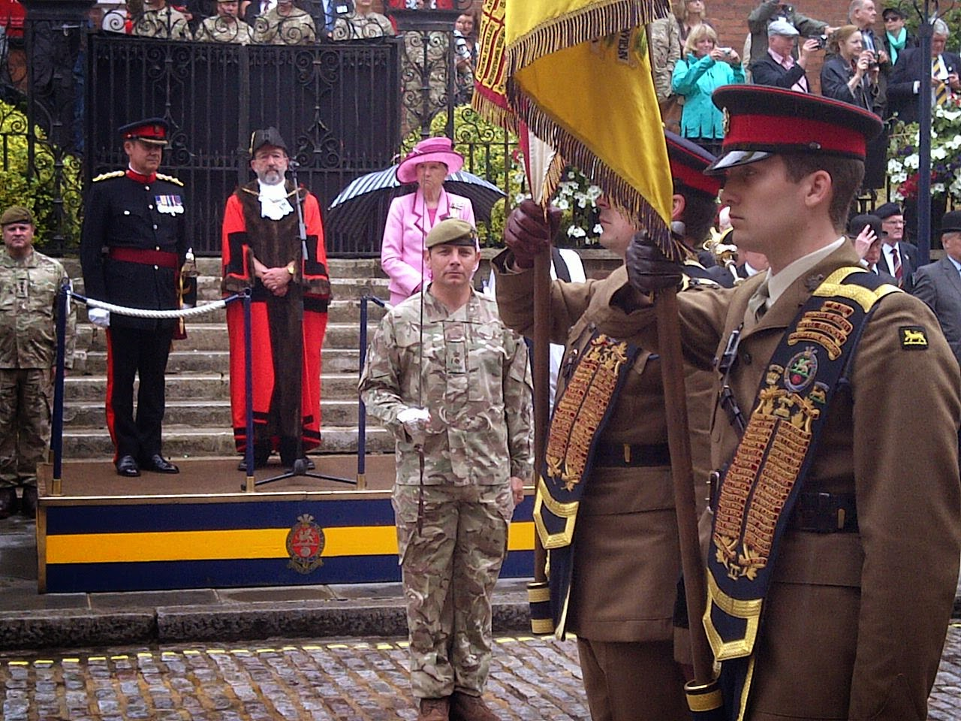
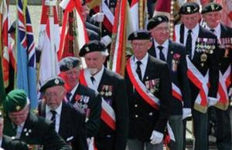
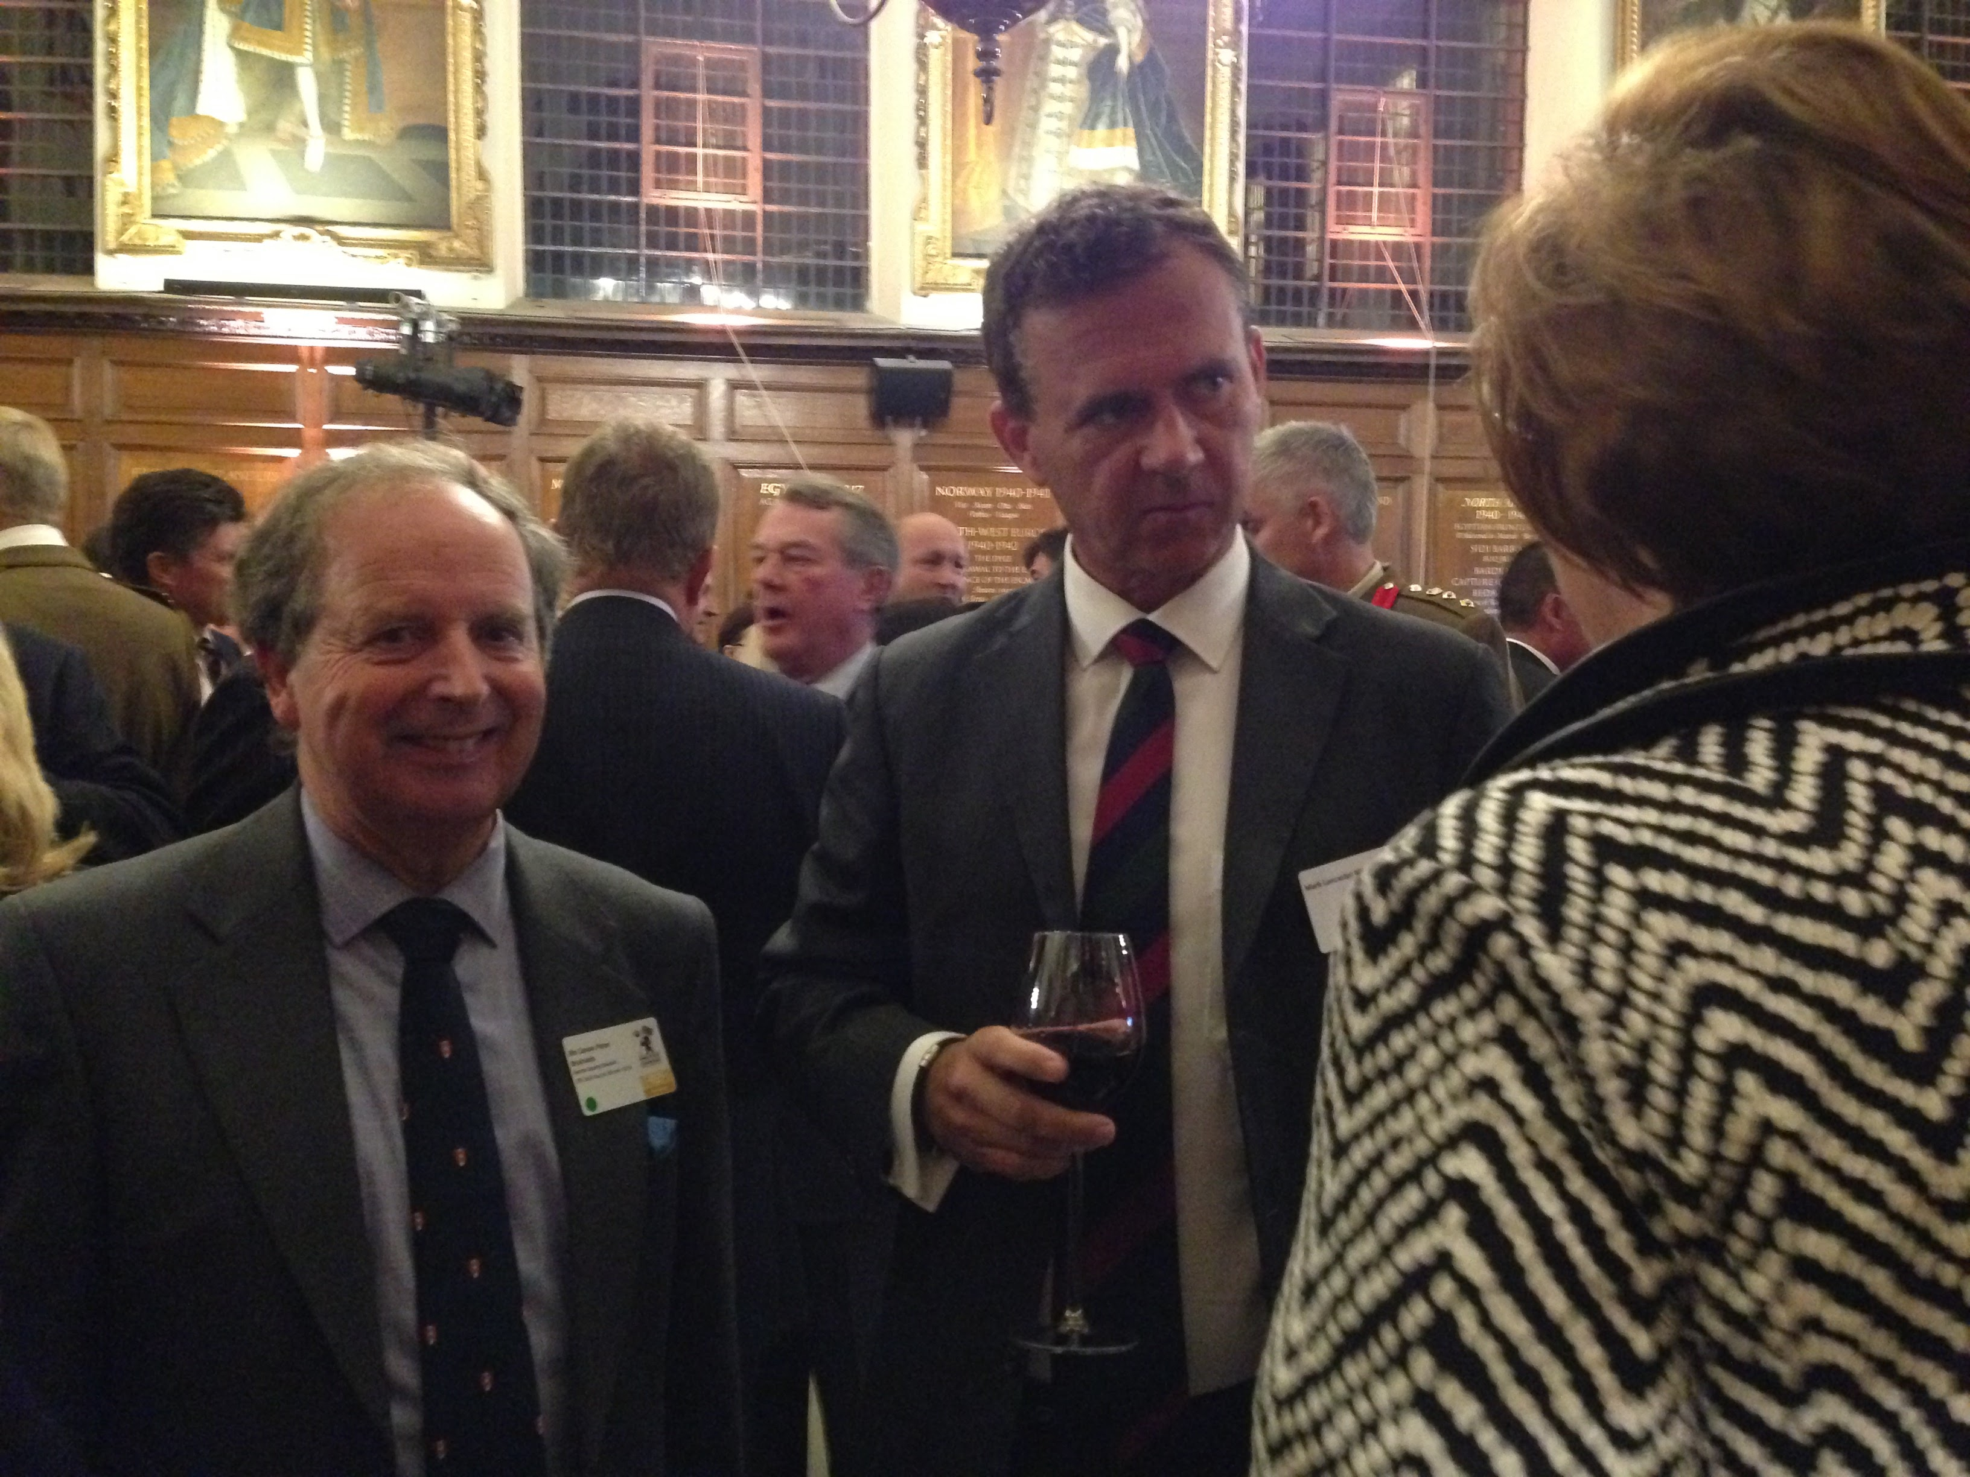
Councillor Armed Forces Champions
Raise profile and needs of Armed Forces Community within the council and local authority area:
Annual meetings, links with MPs
Remembrance and ceremonial
Notes:
This slide sets out some of the roles of the Armed Forces Champion.
They show local Remembrance Parades, Freedom Marches during Armed Forces weeks (last week in June) as well as meetings with MPs.
Job Description:-
To raise the profile and help address needs of the Armed Forces Community
Liaise closely with AFC / Council representative on your County Council/ Local Authority Civilian-Military Partnership Board.
Liaise closely with the Council Officer appointed to lead on work related to Armed Forces Community Covenant.
Set up (where appropriate) and lead on the work Armed Forces Members panel.
To liaise as appropriate with members of local Armed Forces.
To promote the Armed Forces Covenant and the MoD Employers Recognition Awards Scheme to the business community.
To keep abreast of national developments in relation to promoting Armed Forces Covenant and military-civilian engagement.
To sponsor an annual report on Covenant activities.
To keep the Mayor/Chairman, Council Leader, Civic Secretary, local Churches and local MP aware and fully involved on ceremonial matters

Slide 31
So what do I do as a Service Champion?
I champion the needs of the Armed Forces within this department
There are similar Service Champions across Education, Health, Housing, Employment, Transport and Social Care
I liaise with the Covenant Lead within the local authority
I ask ‘Have you served ?’ to ensure no Service / Ex-Service Personnel are disadvantaged
Notes:
Tell them about yourself.
This is all about Service Champions and my lead role in the Department.
How I am now qualified to pass the key messages on – ‘Train the Trainers’.
Need to promote FCSE Courses including this one and the e-Learning Training Module on the Armed Forces Covenant
You can help me!!

Slide 32
Forces Connect South East Cross Border MoD Project
Strengthening local government delivery of the covenant
Two year project
“Promoting a greater understanding and awareness of the issues affecting the Armed Forces Community within public authorities to ensure the Covenant is embedded and mainstreamed in service delivery, through sharing and building on best practice.”
Notes:
This training is provided through a MoD Covenant funded grant of £321,300 to Surrey County Council on behalf of Forces Connect South East.
Forces Connect South East is a partnership led by Surrey with West Sussex, Hampshire, Kent and East Sussex, Brighton & Hove and Medway Councils , Sussex, Kent and Medway CCGs, Royal British Legion and SSAFA.
It is looking at sharing best practice and ensuring consistent advice across the Region to the Armed Forces Community as well as a total understanding of the implications of the Armed Forces Covenant with fully trained front line staff able to recognise the needs of that community.
£321,300 includes £40K from the MoD to ‘roll it out nationally’.

Slide 33
Training and Contacts
E-learning Armed Forces Covenant Training Module
Frontline staff awareness training
Service Champions Training
Surrey County Council Officer Contacts:
Sarah Goodman – armedforces@surreycc.gov.uk
Canon Peter Bruinvels – canonpeter.bruinvels@surreycc.gov.uk
Chairman of SCMPB and Armed Forces Champion
Mr Peter Martin – chairmans.office@surreycc.gov.uk
www.surreycc.gov.uk/armedforces
http:/www.sussexarmedforcesnetwork.nhs.uk/
service-champions/surrey
Insert Local Information
Notes:
These are Surrey CC Contacts – and I can give you local contacts for each district and borough council.
The e-Learning Training Module – The Armed Forces Covenant for Frontline staff is already available in Kent and in Surrey, through the Surrey Skills Academy and is about to be made available across Hampshire and West Sussex – it takes about 40 minutes to complete, and I would encourage you all to do this if you haven’t done so already.
Elected Councillor training is offered to all Elected Councillor Armed Forces Champions and their Covenant Officer Leads through PETER BRUINVELS ASSOCIATES (PBA) – our Training Provider
Customer Facing Front Line Staff Training is offered to all staff and lasts 45 minutes and is provided through PBA and trained Service Champions
Service Champion Training is available through SUSSEX ARMED FORCES NETWORK to those who would like more in depth training and would like to help spread the message – please email ArmedForces@surreycc.gov.uk if you would like more information. Referral pathways have been developed by SUSSEX ARMED FORCES NETWORK. These cover issues such as employment, education and housing and are available via the website and an APP when it is finalised http:/www.sussexarmedforcesnetwork.nhs.uk/service-champions/surrey

Slide 34
Key Points
Remember to ask ‘Have you served?’
Recognise the unique aspects of service life
Use the knowledge learnt on this course to better assist and support the needs of the Armed Forces Community
Have at your finger tips / mouse / ‘App’ and point of contact to give advice and guidance
Notes:
Useful Aid Memoire

Slide 35
Resource Materials (1)
The Armed Forces Covenant Annual Report 2017 www.armedforcescovenant.gov.uk
Service Children – best practice for use of Service Pupil Premium https://nff.org.uk/service-pupil-premium-guide
Employers and Defence – SERFCA www.serfca.org
Why having Reservists is good for your business - Skills Set of the Army .../reservists-are-good-for-business.pdf
Defence Focus –The Pecking Order defence-focus-magazine
CTP Resettlement Guides https://www.ctp.org.uk
MoD Service Leavers Guide
https://www.gov.uk/government/uploads/ServiceLeaversGuide
8. Joint Service Housing Advice Office
Notes:
And much more!
Some suggestions, mainly on-line

Slide 36
Resource Materials (2)
SE Veterans Advisory and Pensions Committee
- Veterans UK https://www.gov.uk/government/organisations/veterans-uk
Service Families Federation Links
10. Naval Families Federation: NFF https://nff.org.uk/
11. Army Families Federation: Home https://aff.org.uk
12. RAF Families Federation: Home
https://www.raf-ff.org.uk/
13. Defence Discount Service and App
https://www.defencediscountservice.co.uk
14. Armed Forces Covenant Fund Trust
www.covenantfund.org.uk/
*Contains public sector information licensed
under the Open Government Licence v3.0

Slide 37
Questions and Answers Next Steps Thank you for coming!

